Slide 1
Introduction of the YesPanda web service
YesPanda web service is a lightweight project for making our staff quickly and easily access station yield rate data. It build with Ruby, Rails, MySQL and Bootstrap
David Wang @ Quanta 2016

Slide 2
Design of the web service
Users can sign up and sign in. (All actions of web and API request need an authenticated token to access)
Only the users who have admin privilege can import yield report files to server. (Login Role Management module has not implemented yet)
The yield report data (CSV file) will be automatically imported to database server.
All signed in users can browse the imported timely yield report data by specific Station (and Config).
The web service also provides a backend JSON API.

Slide 3
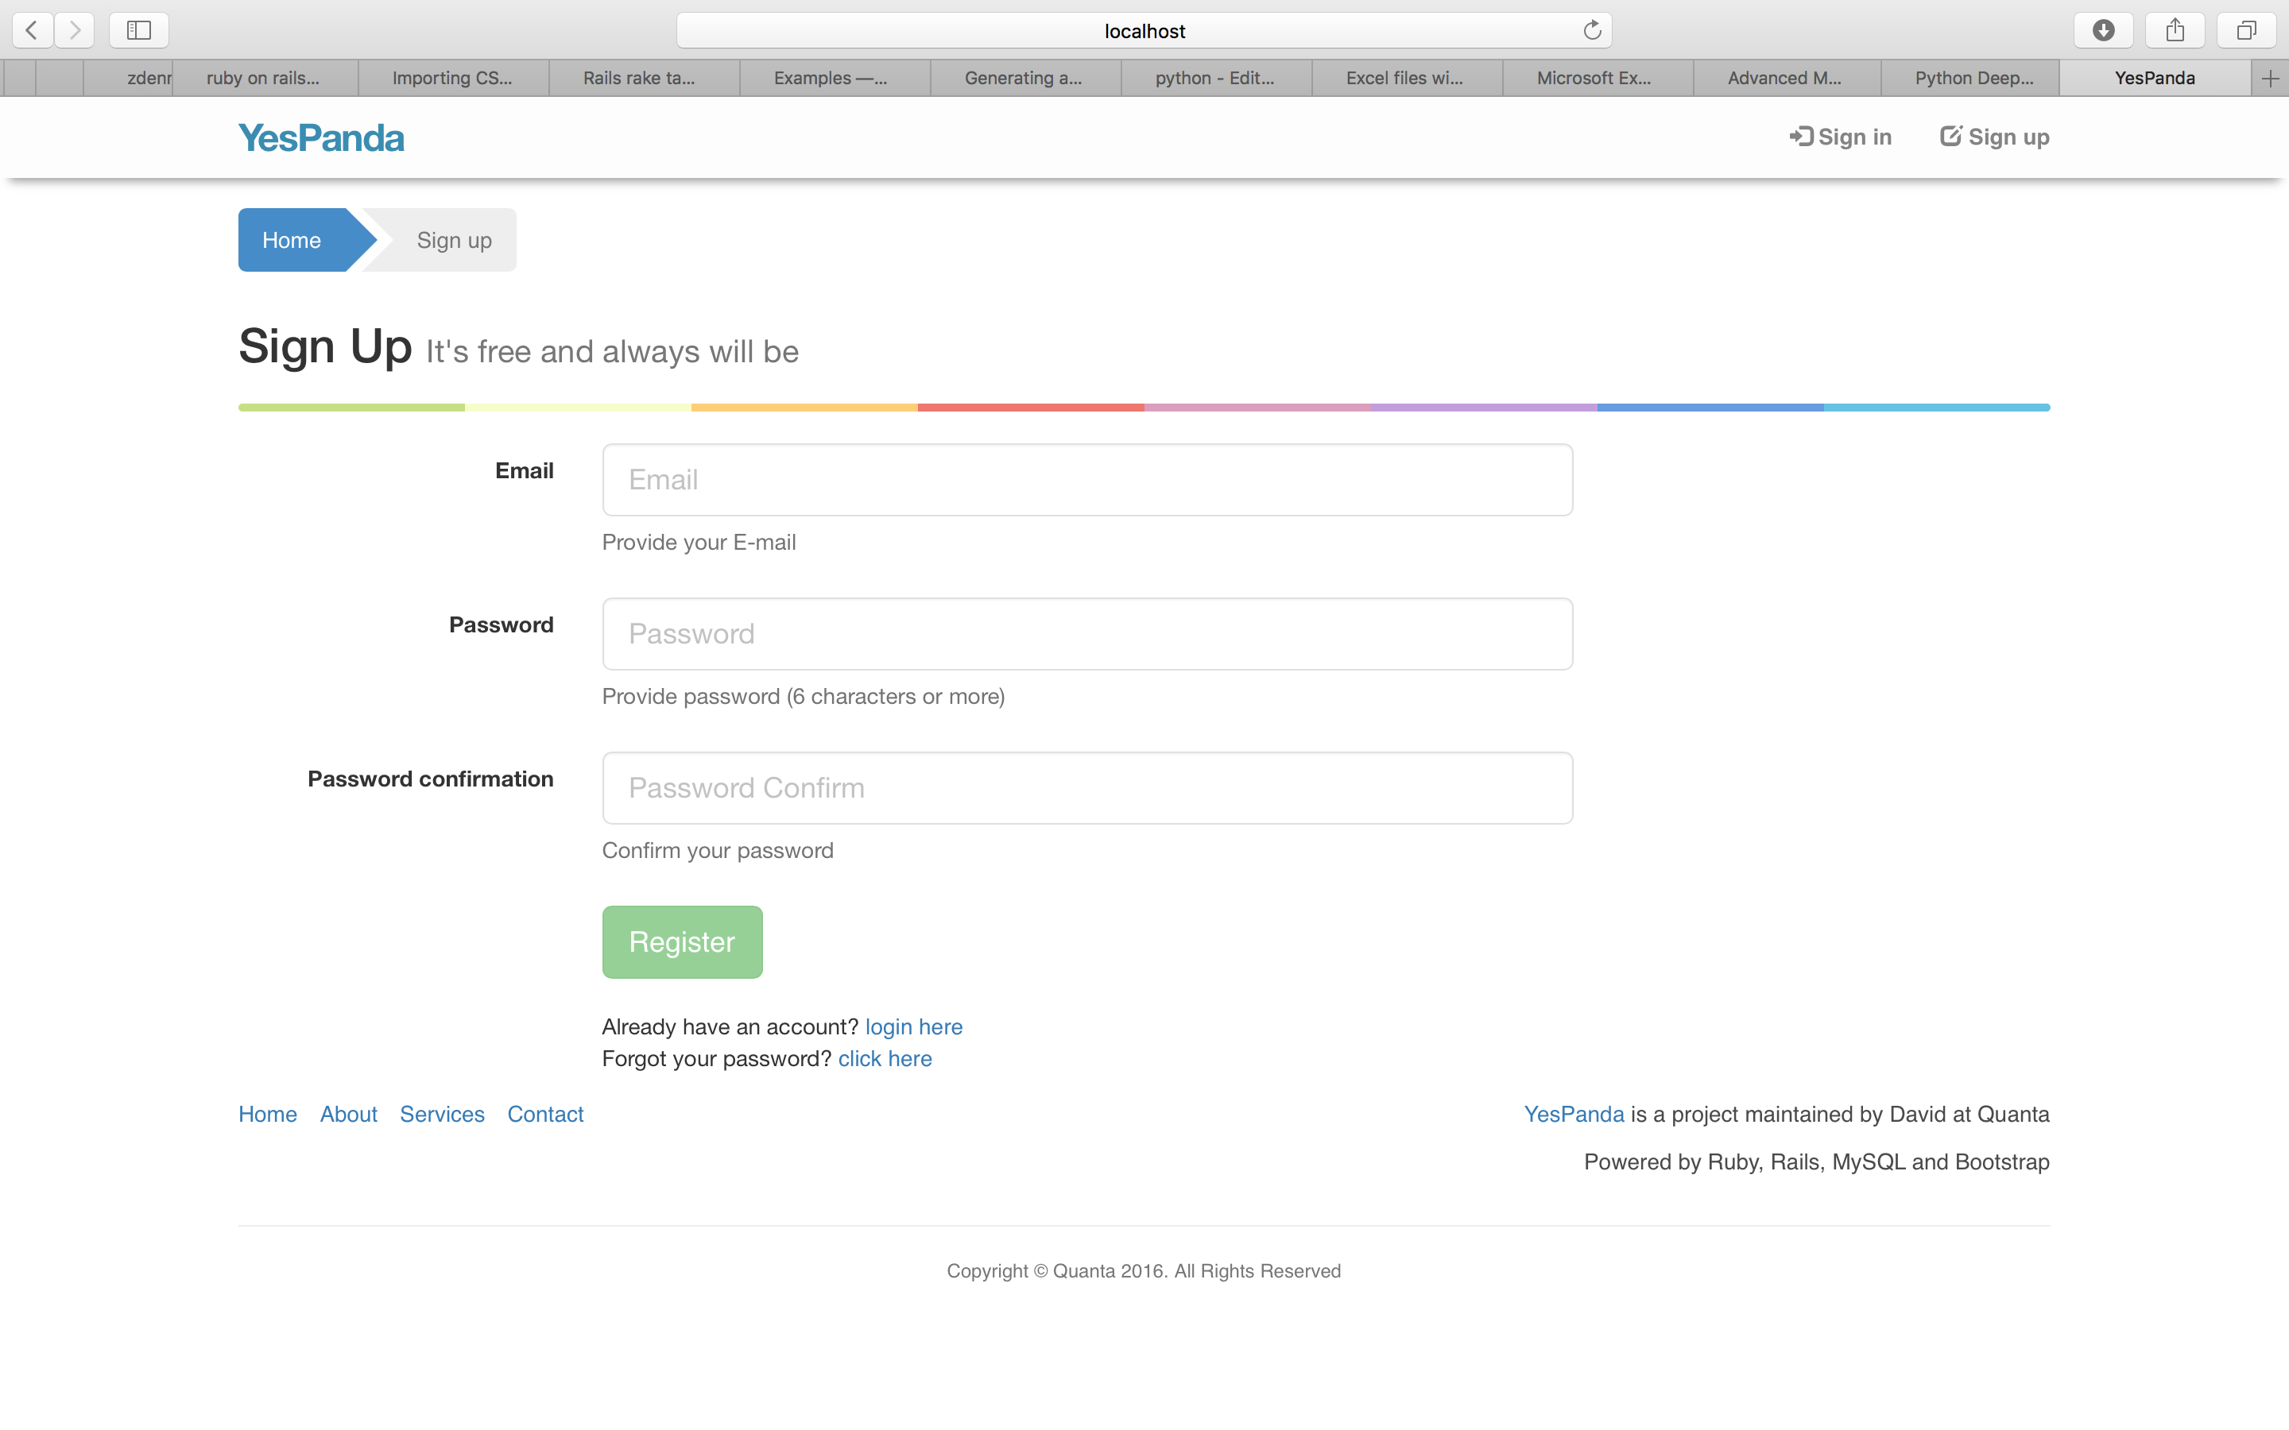
User sign-up page

Slide 4
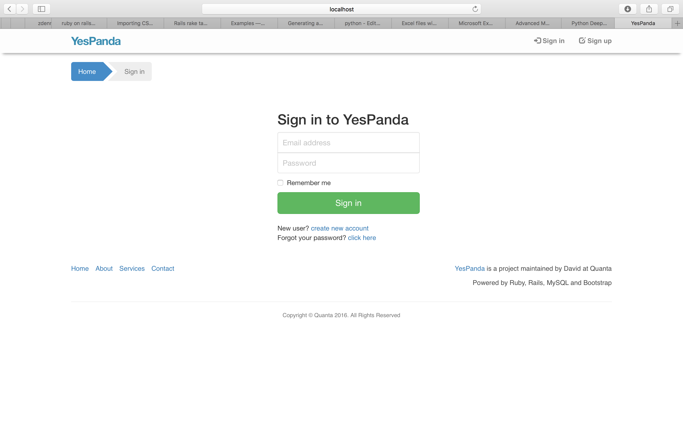
User sign-in page

Slide 5
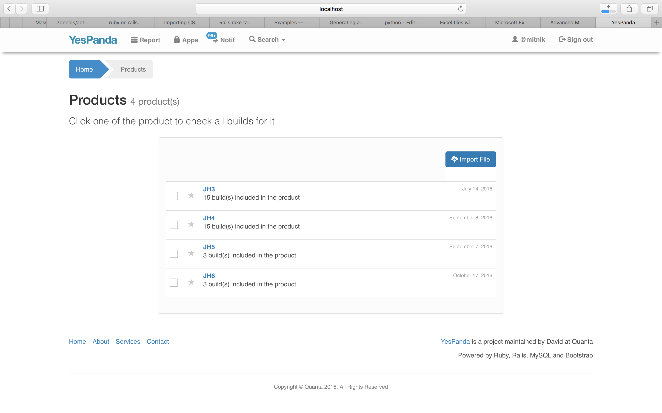
After yield report (CSV) files imported, categorized product names will be shown in “Report” page.
Users can select one product name to check all of the builds of it.

Slide 6
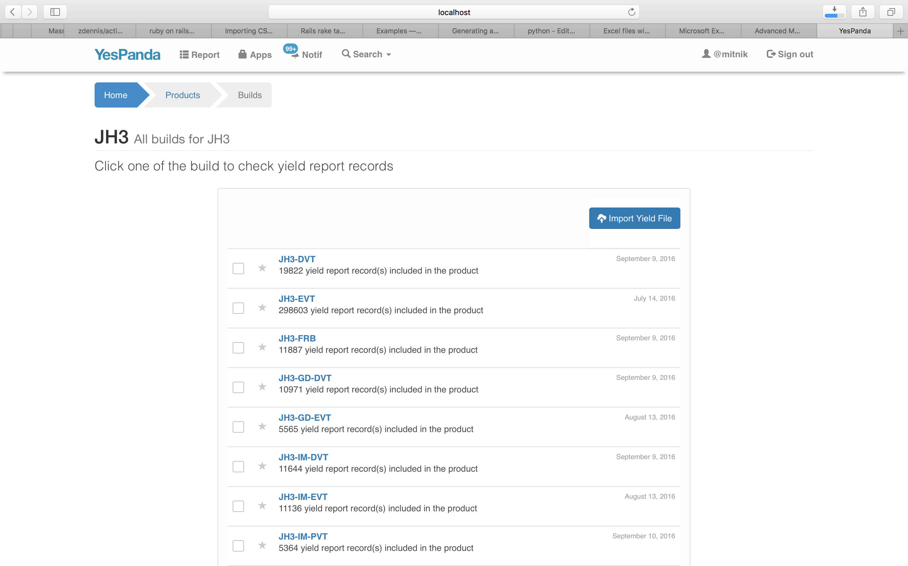
After click a product name, you can browse builds and select one of it to check the yield reports.

Slide 7
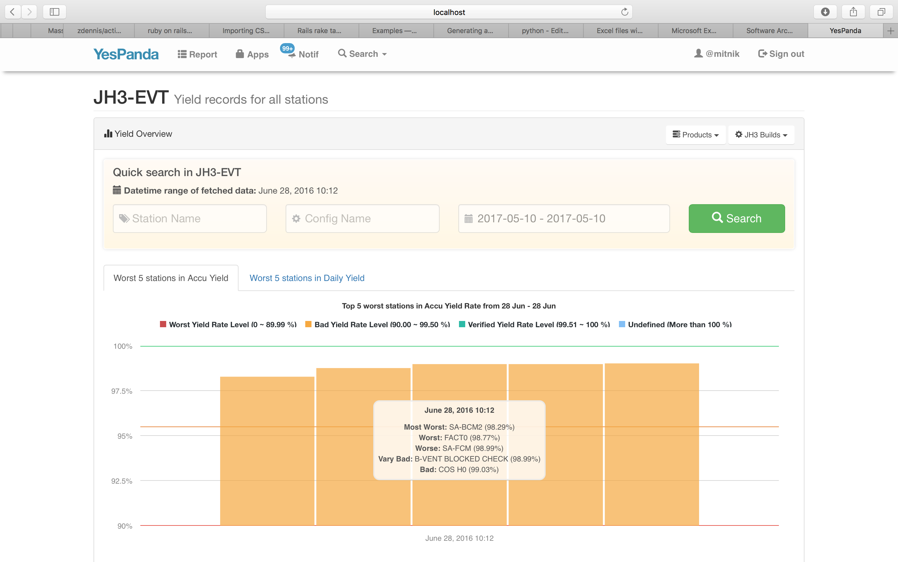
You can change to check yield rate of other “Products” and “Builds” by dropdown menu
Show 2 types of charts for JH3-EVT yield rate
We use different colors in chart for indicating the yield rate level (Worst to Verified)
The chart shows the 5 stations that have worst Accumulated Yield Rate in today

Slide 8
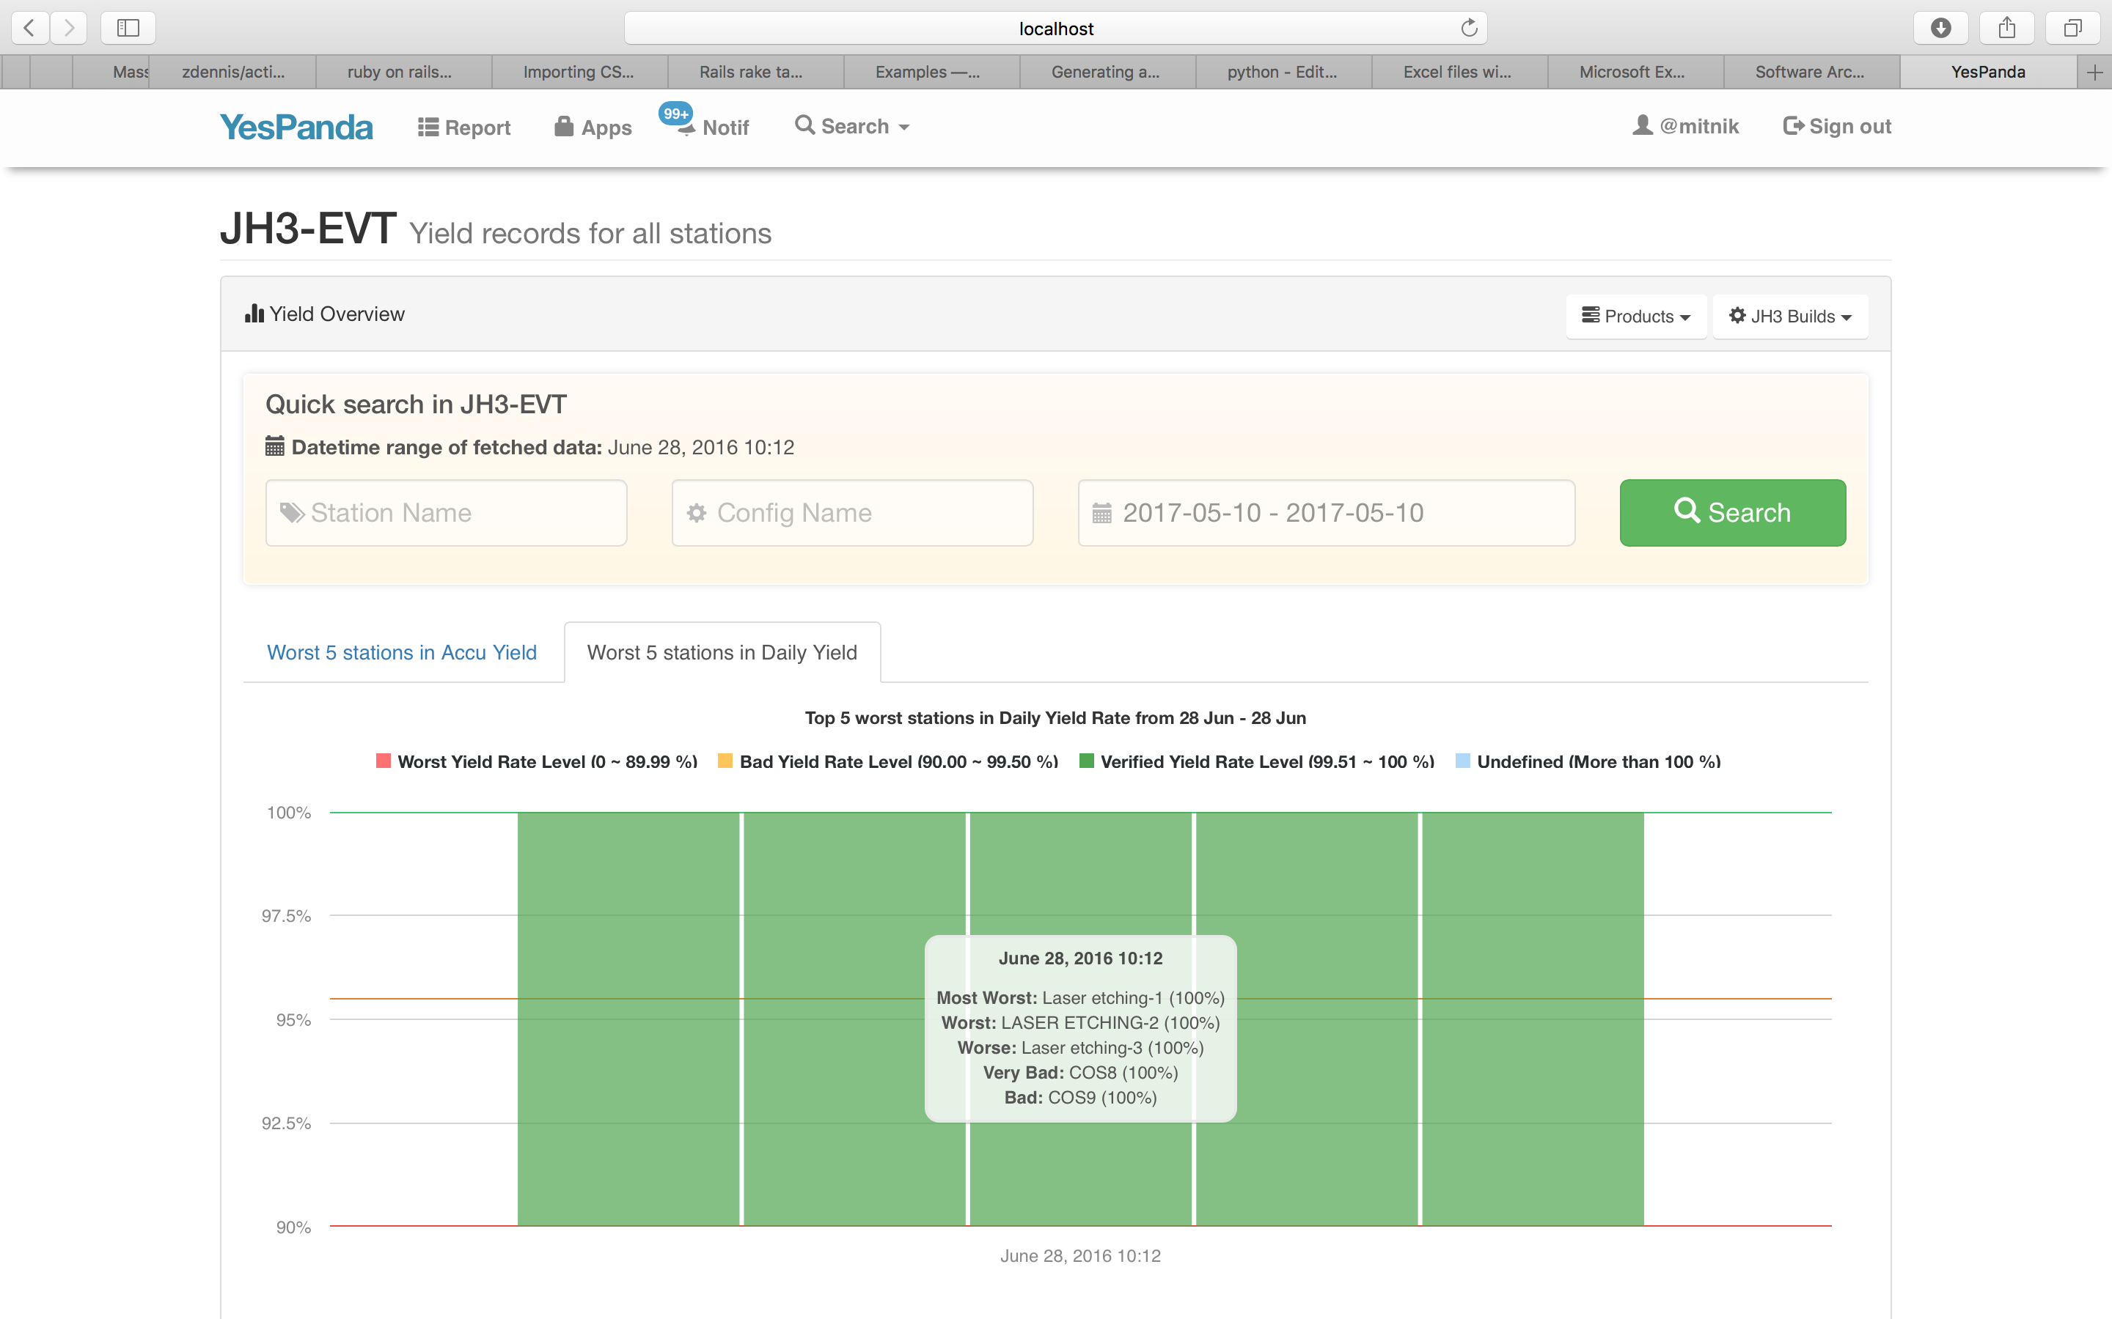
Additionally, you can also quickly checking yield rate of other “Station” and “Config” in JH3-EVT by using the search box
The chart shows the 5 stations that have worst Daily Yield Rate in today

Slide 9
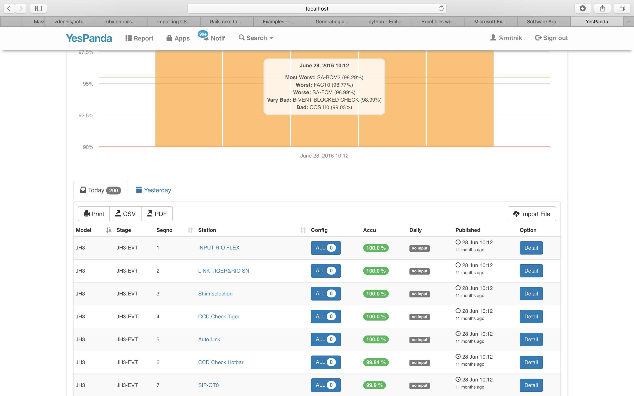
Quickly switch to check the yield rate data of Today or Yesterday
You can also print or export the below yield rate data
Yield rate data area

Slide 10
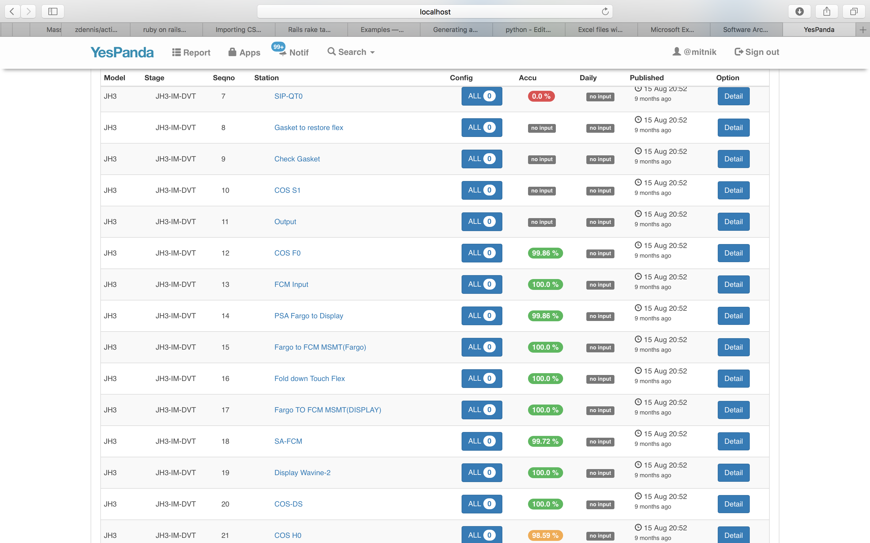
Can check detail info
The Yield rate shown with different colors to help you easily identifying the bad yield rate

Slide 11
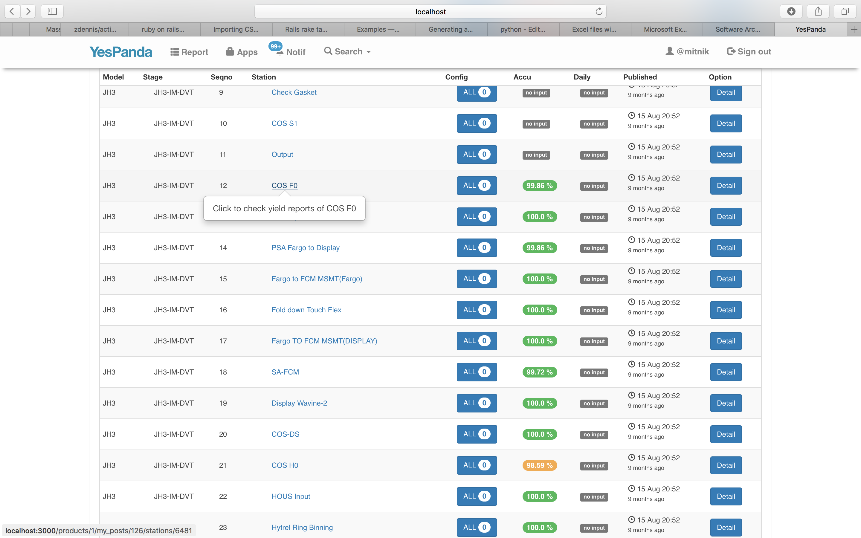
By click the station name, you can check “Daily Yield Data” & “Hourly Yield Data” of that station in specific Model and Stage with different types of charts

Slide 12
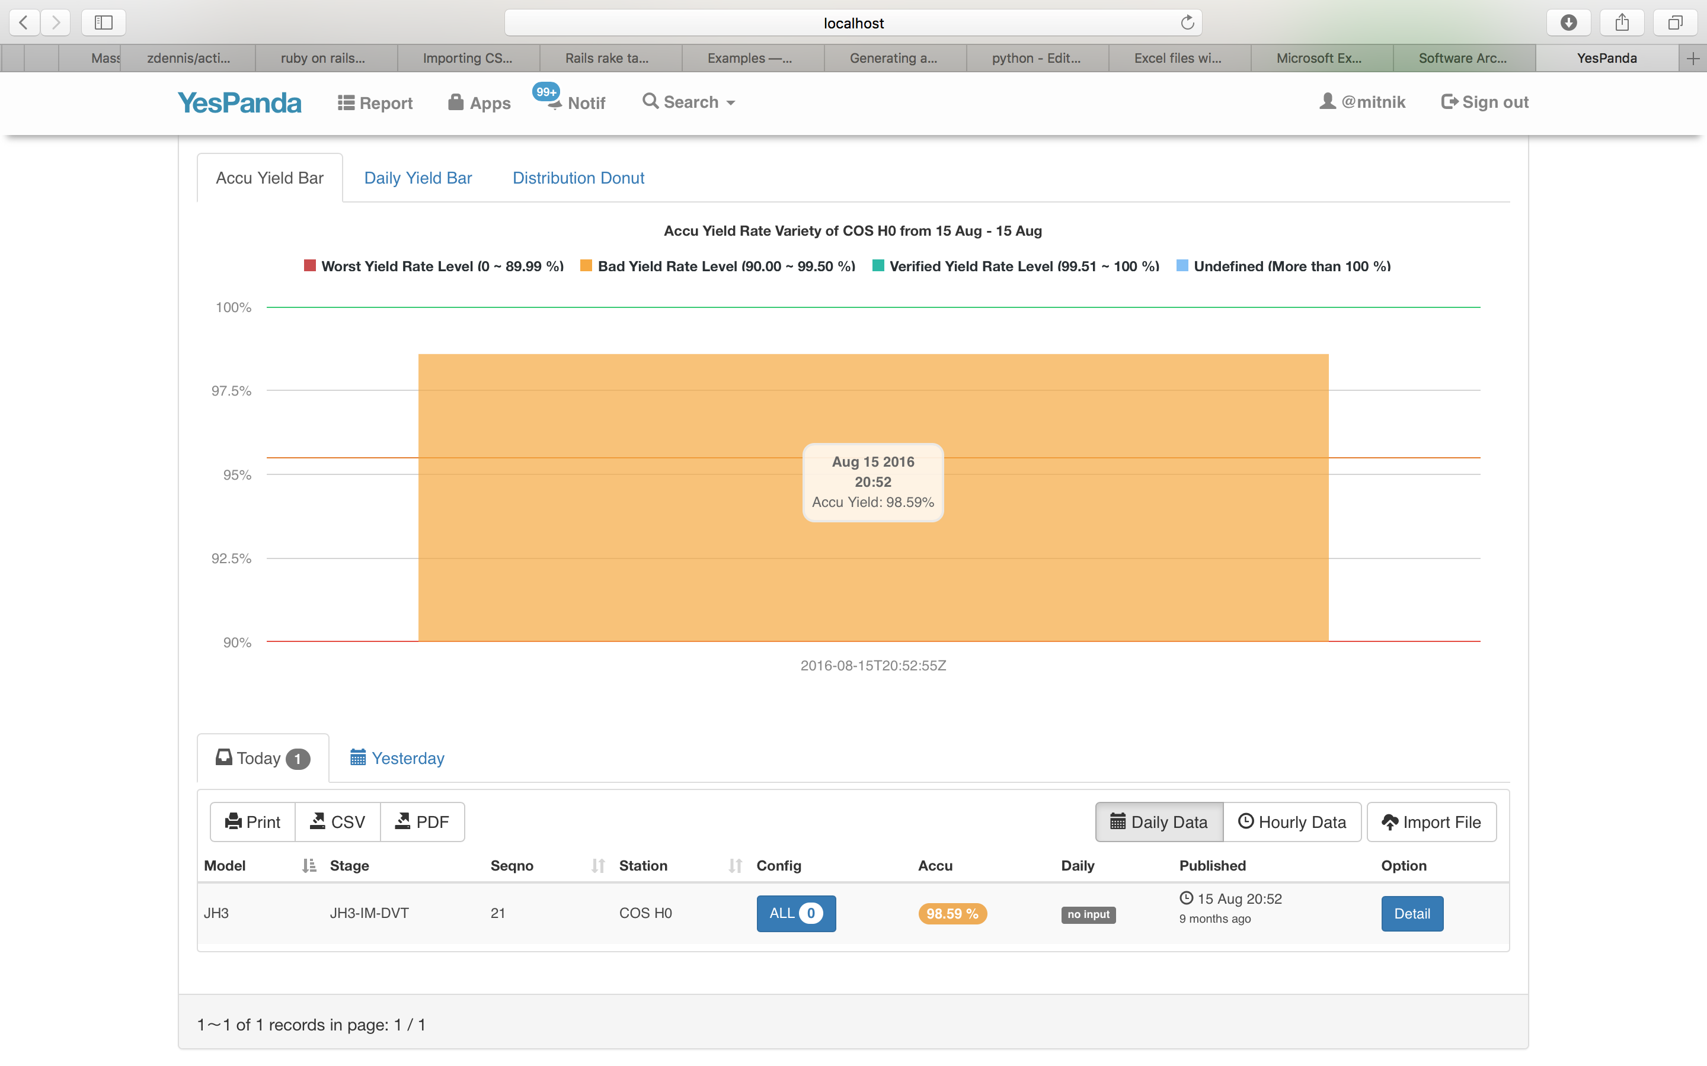
Showing of “COS H0” Daily Yield Data with Bar Char

Slide 13
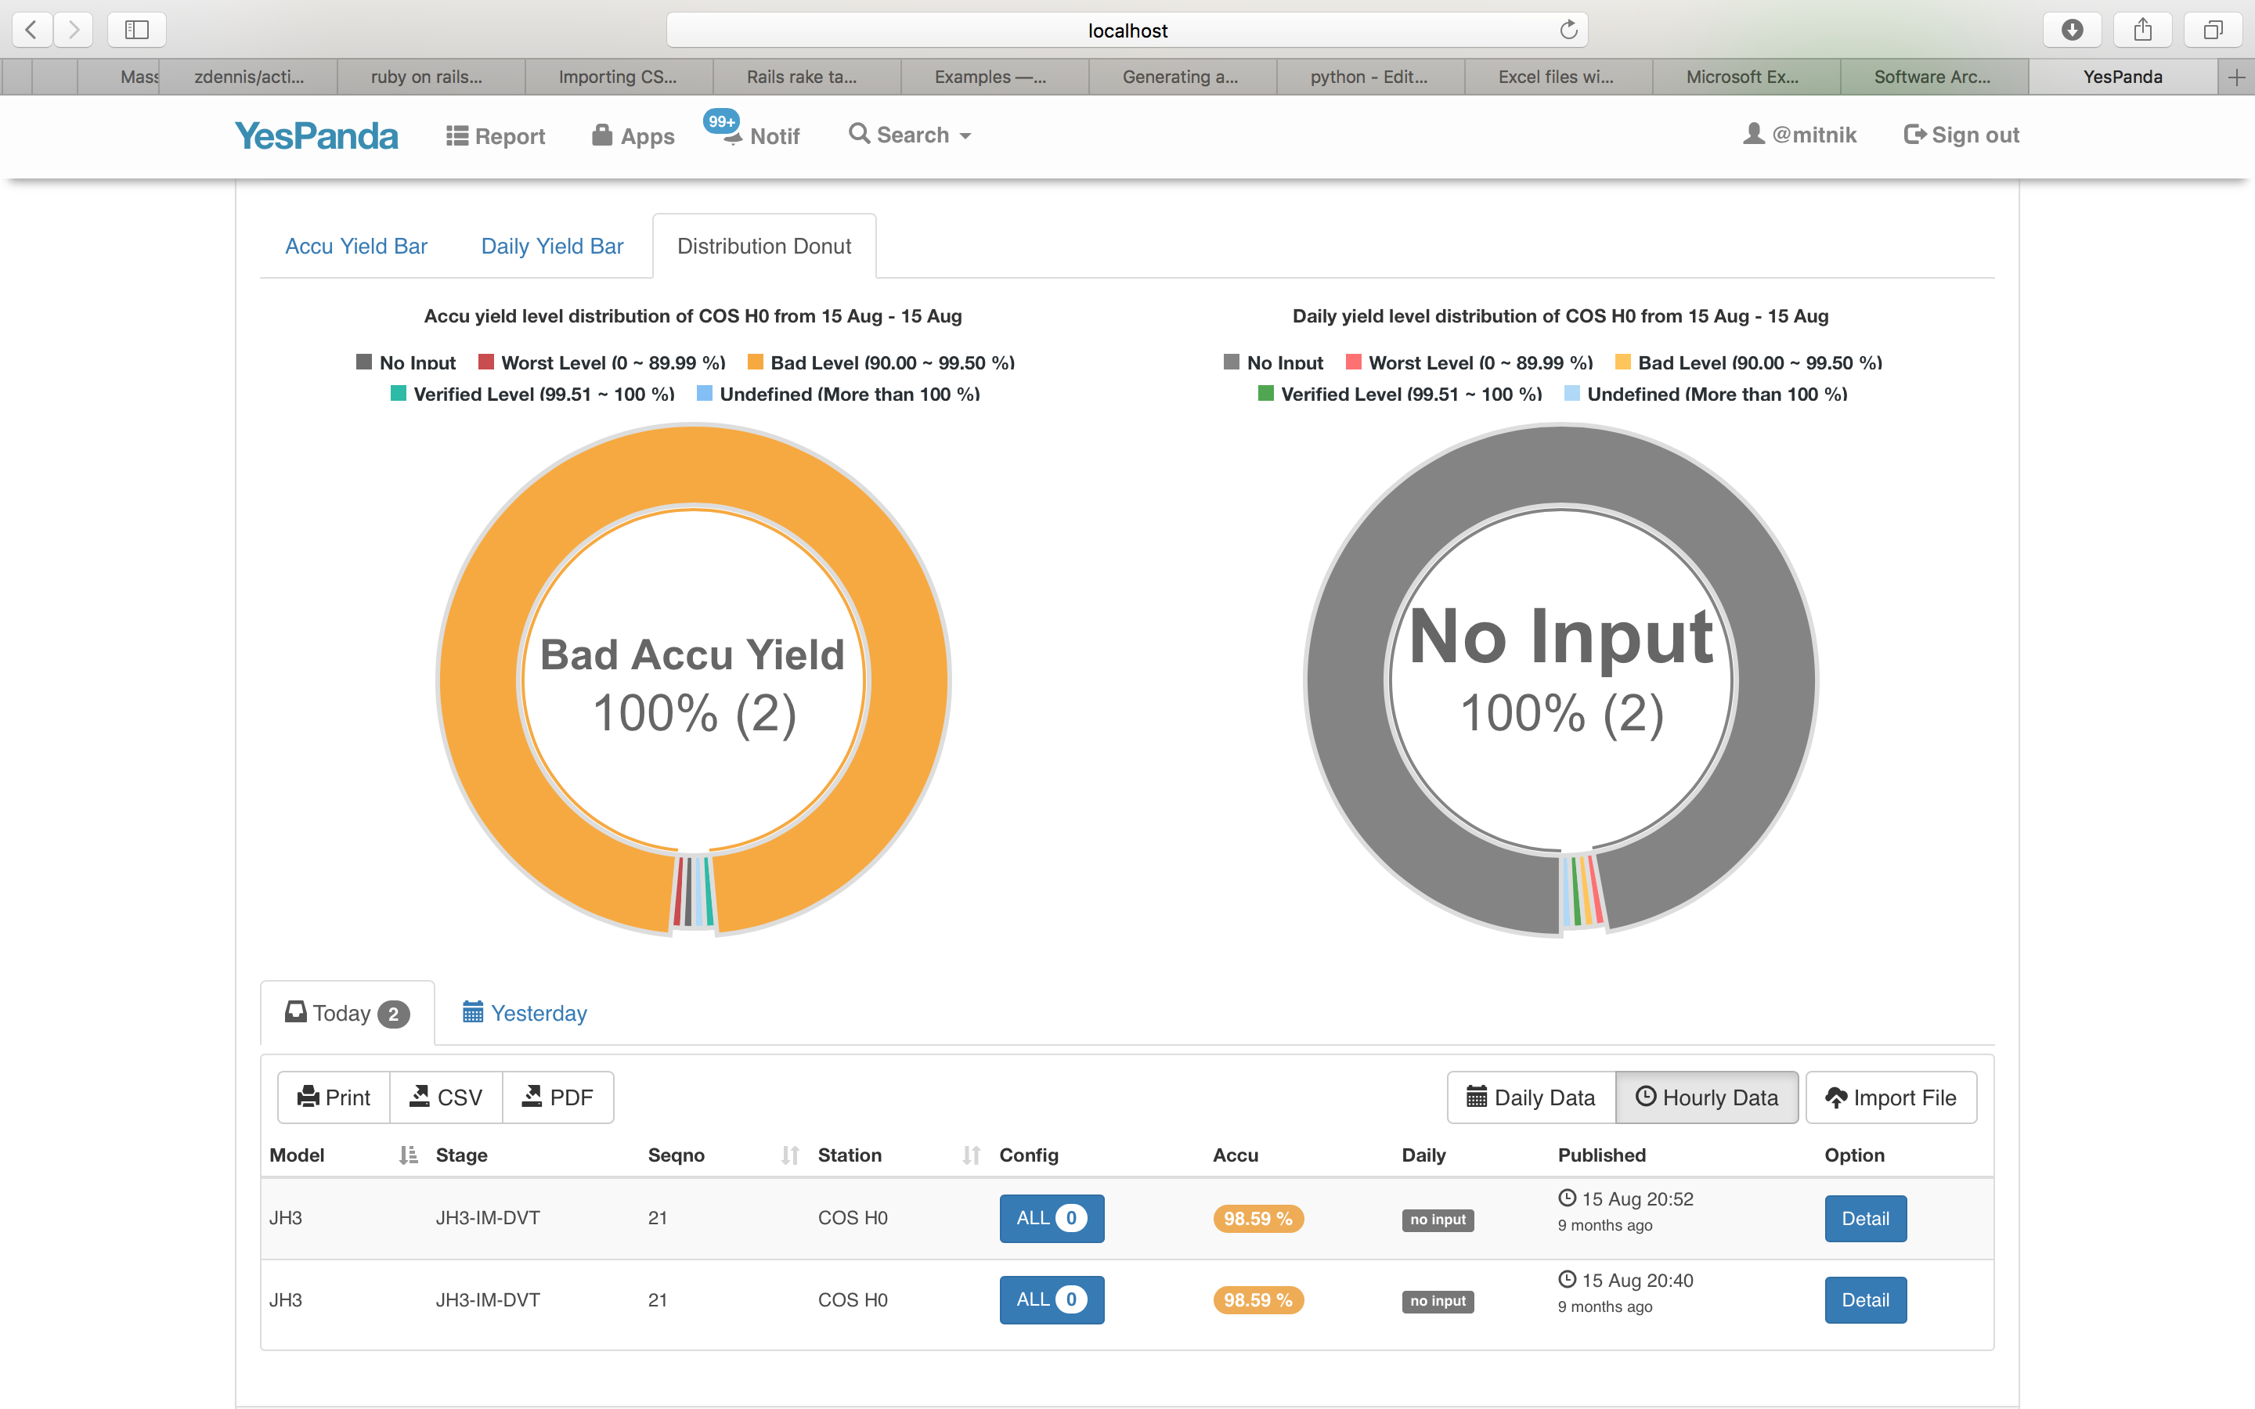
Showing of “COS H0” Hourly Yield Data with Donut Char

Slide 14
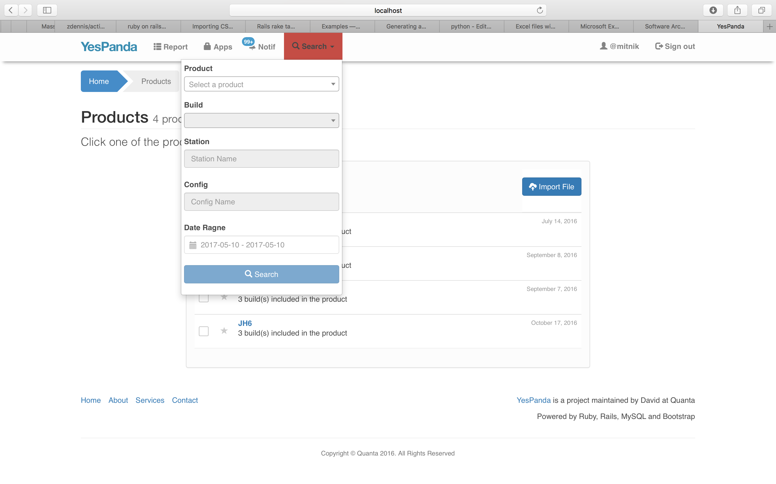
Furthermore, YesPanda web provides a global search box, allows you quickly getting the yield rate data page by given Product, Build, Station, Config and Date Range

Slide 15
Scenario of the use case
You are station DRI, and you want to check the yield rate variety of “QT2 Pre-Roxer” station in JH4-DVT with date period (2016/8/16~18)

Slide 16
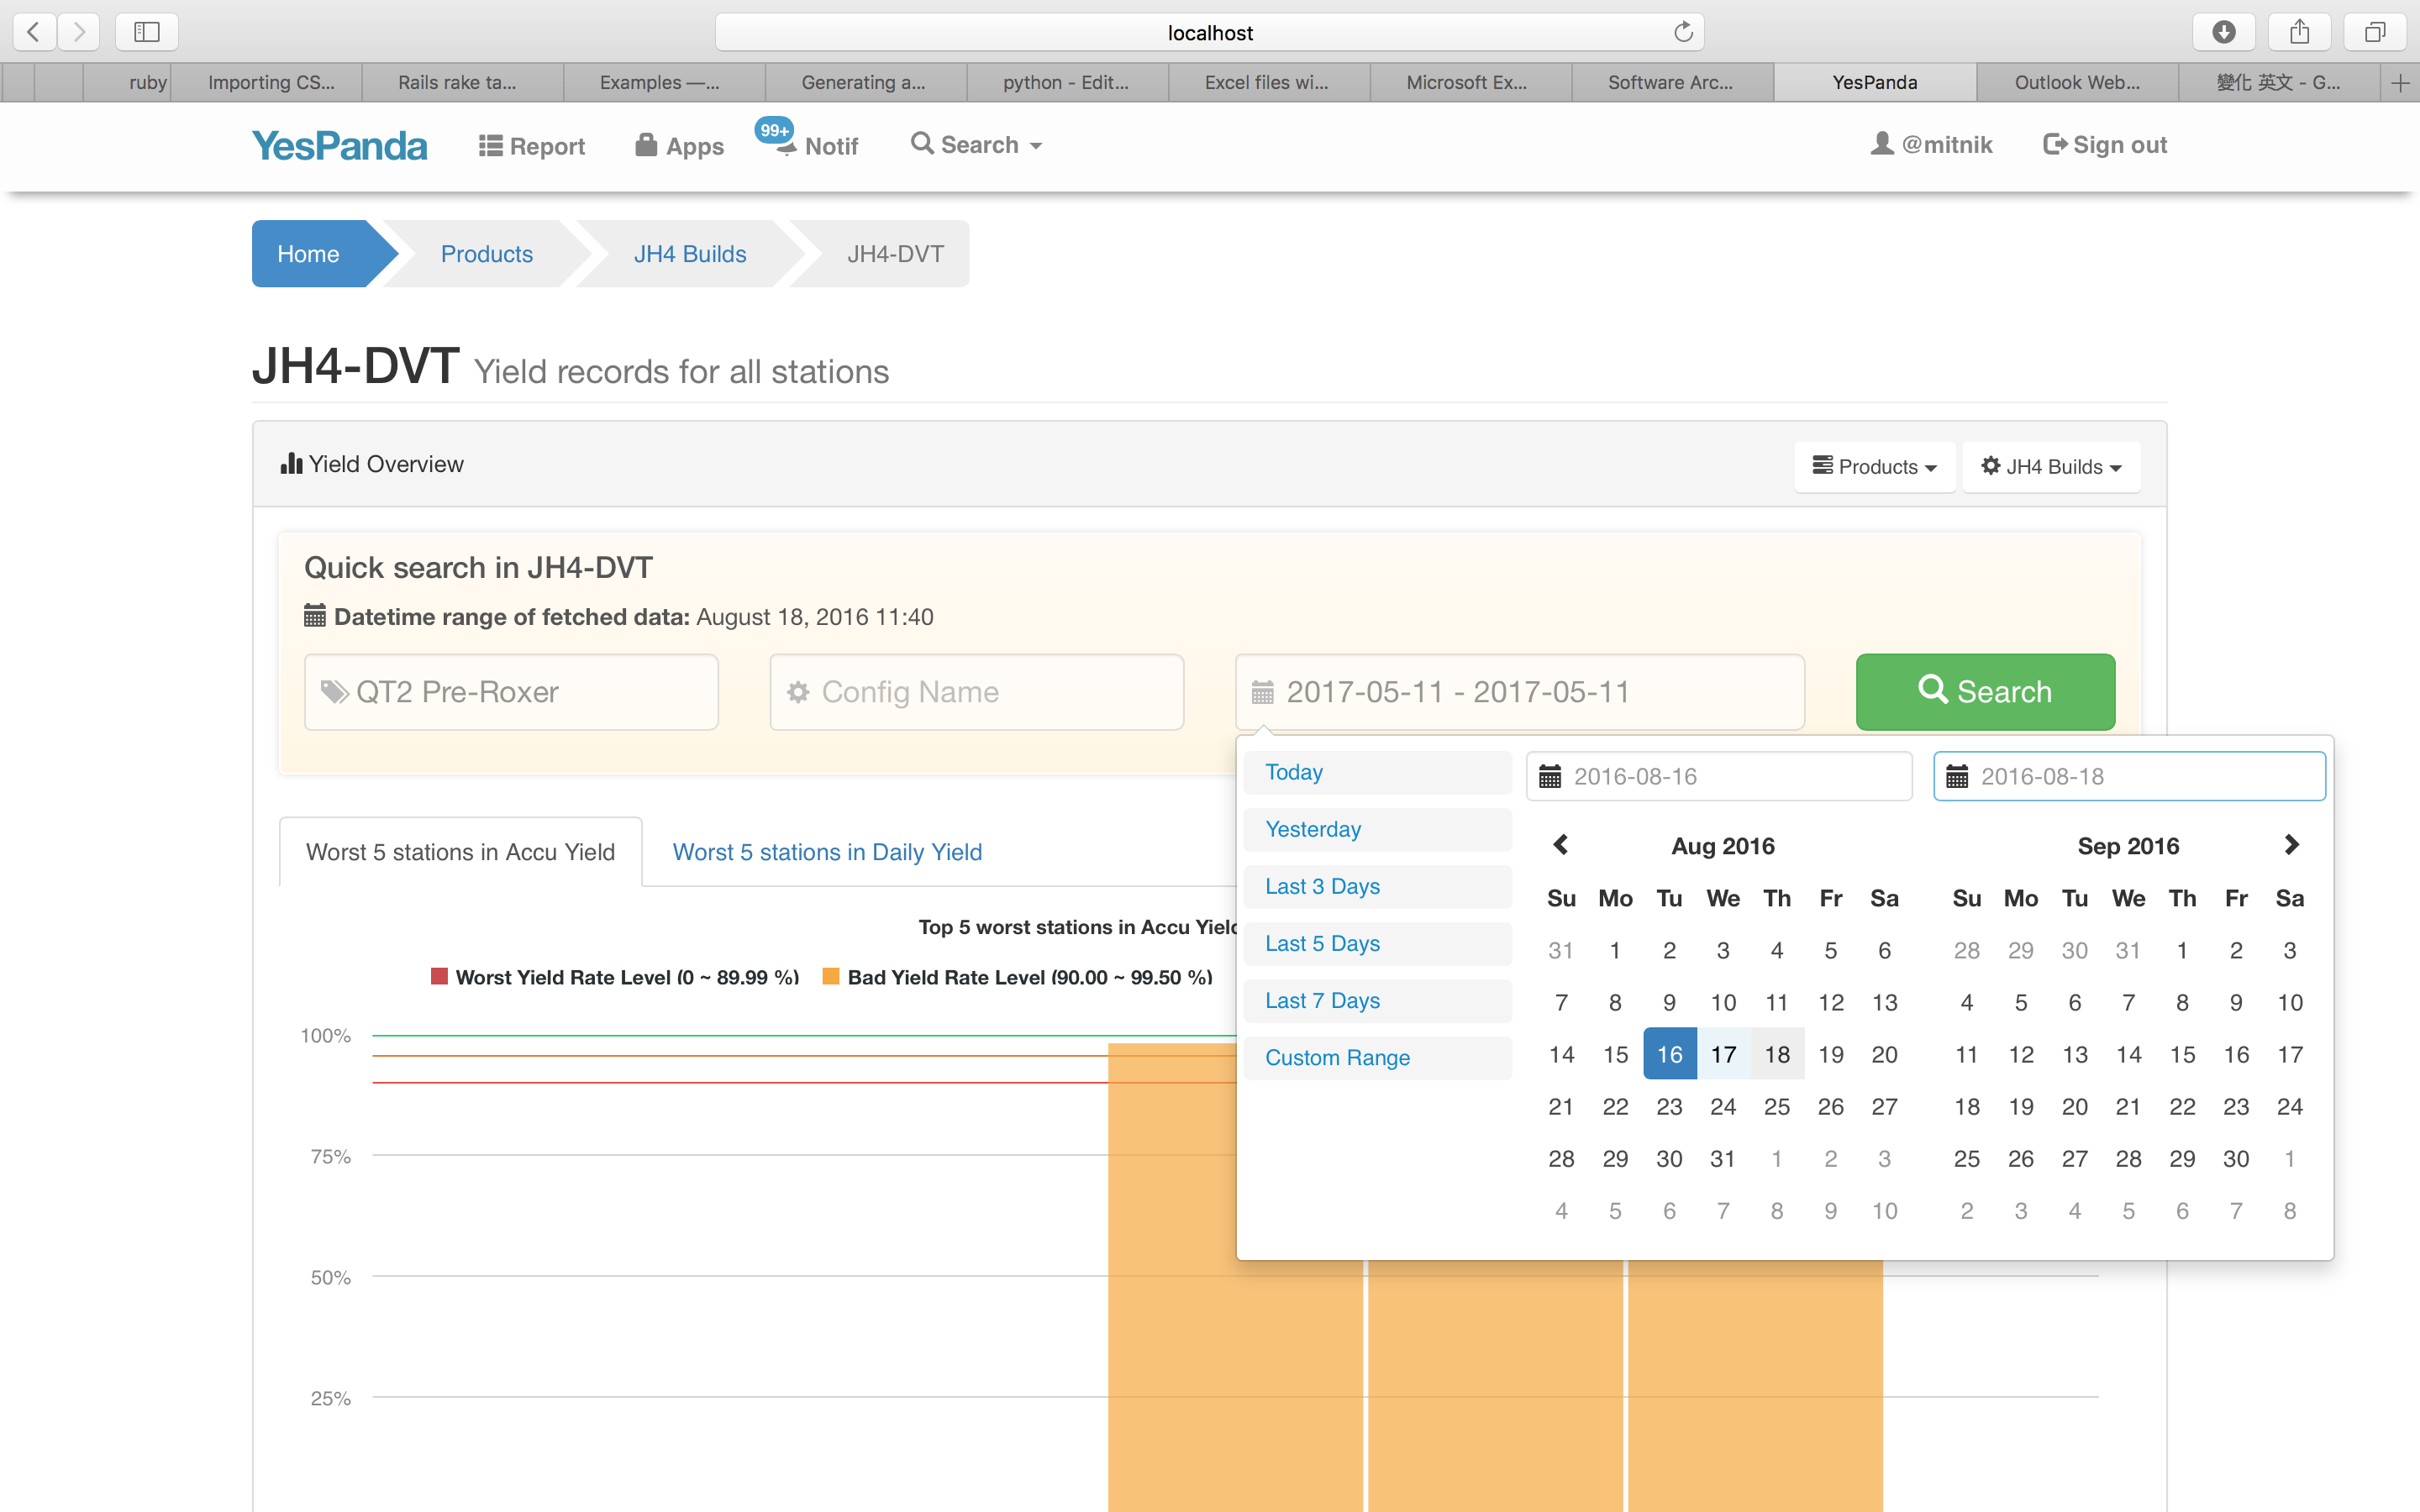
Go into JH4-DVT page
1. Enter the station name here
3. Press Search button
2. Select date range by using date picker

Slide 17
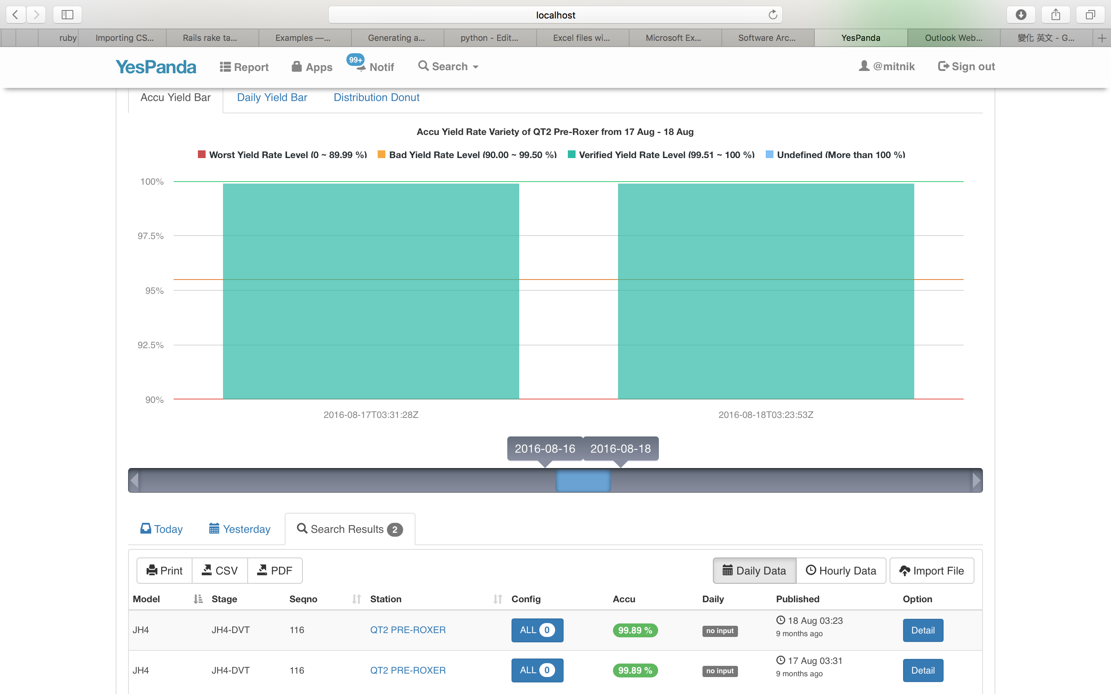
Search results give you the variety of yield rate data of “QT2 Pre-Roxer” station in JH4-DVT with bar chart and donut chart
You can quickly browse yield rate change in different dates by using the scroll bar
And you can quickly switch to check Daily or Hourly yield data

Slide 18
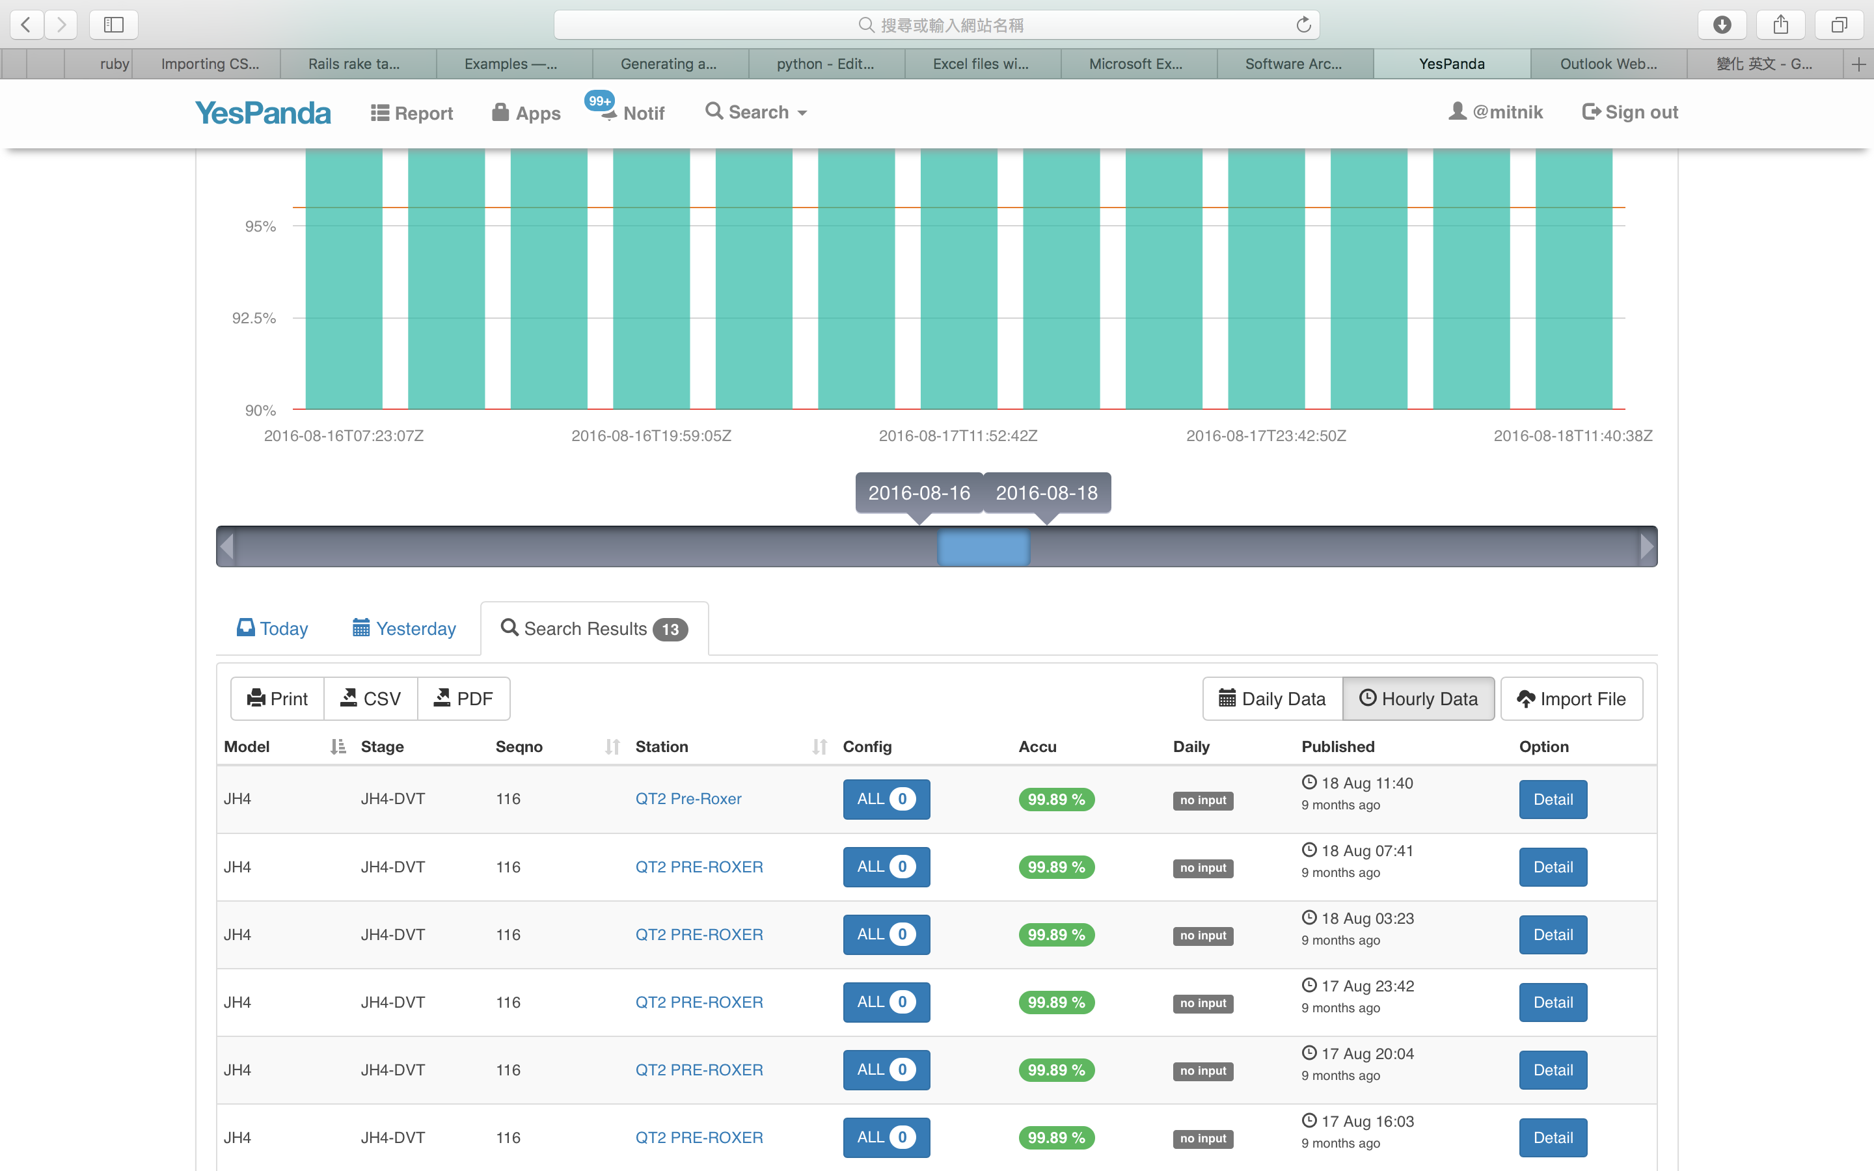
Click the button to switch to “Hourly Data”

Slide 19
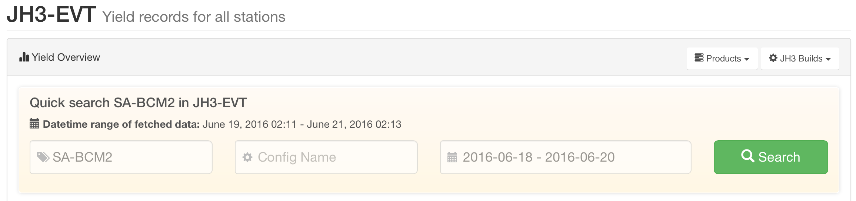
Scenario of the use case
You are station DRI, and you want to check the yield rate variety of “SA-BCM2” station in JH3-EVT with date period (2016/6/18~20), and then you want to check Accu/Daily yield rate of each Config in “SA-BCM2”

Slide 20
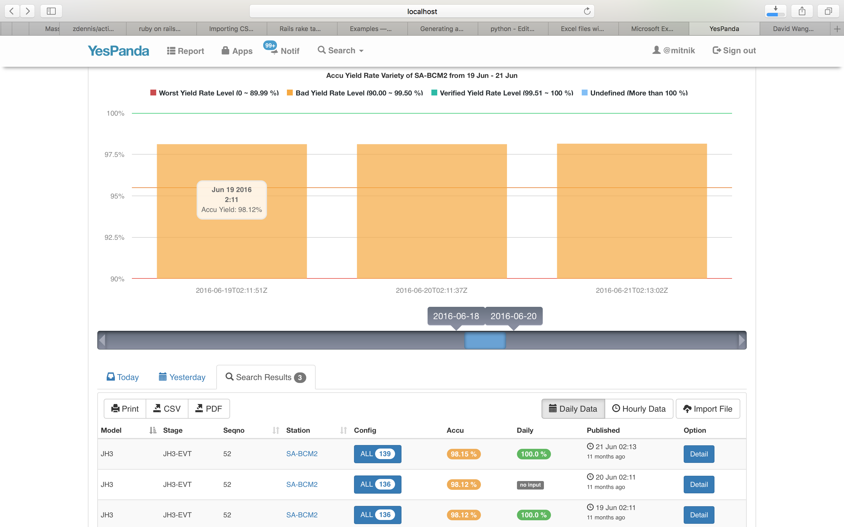
The charts show the yield rate of “SA-BCM2” station during 6/18~20
You can switch to check Hourly Yield Data

Slide 21
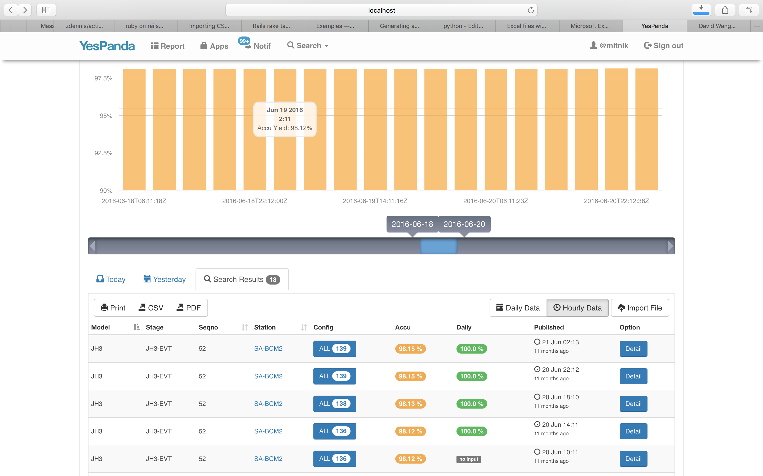
Hourly Yield Data for “SA-BCM2” during 6/28~20
By clicking the Config button, you can browse all configs of SA-BCM2 in JH3-EVT, and check the Accu/Daily yield rate of each Config in specific date or hour

Slide 22
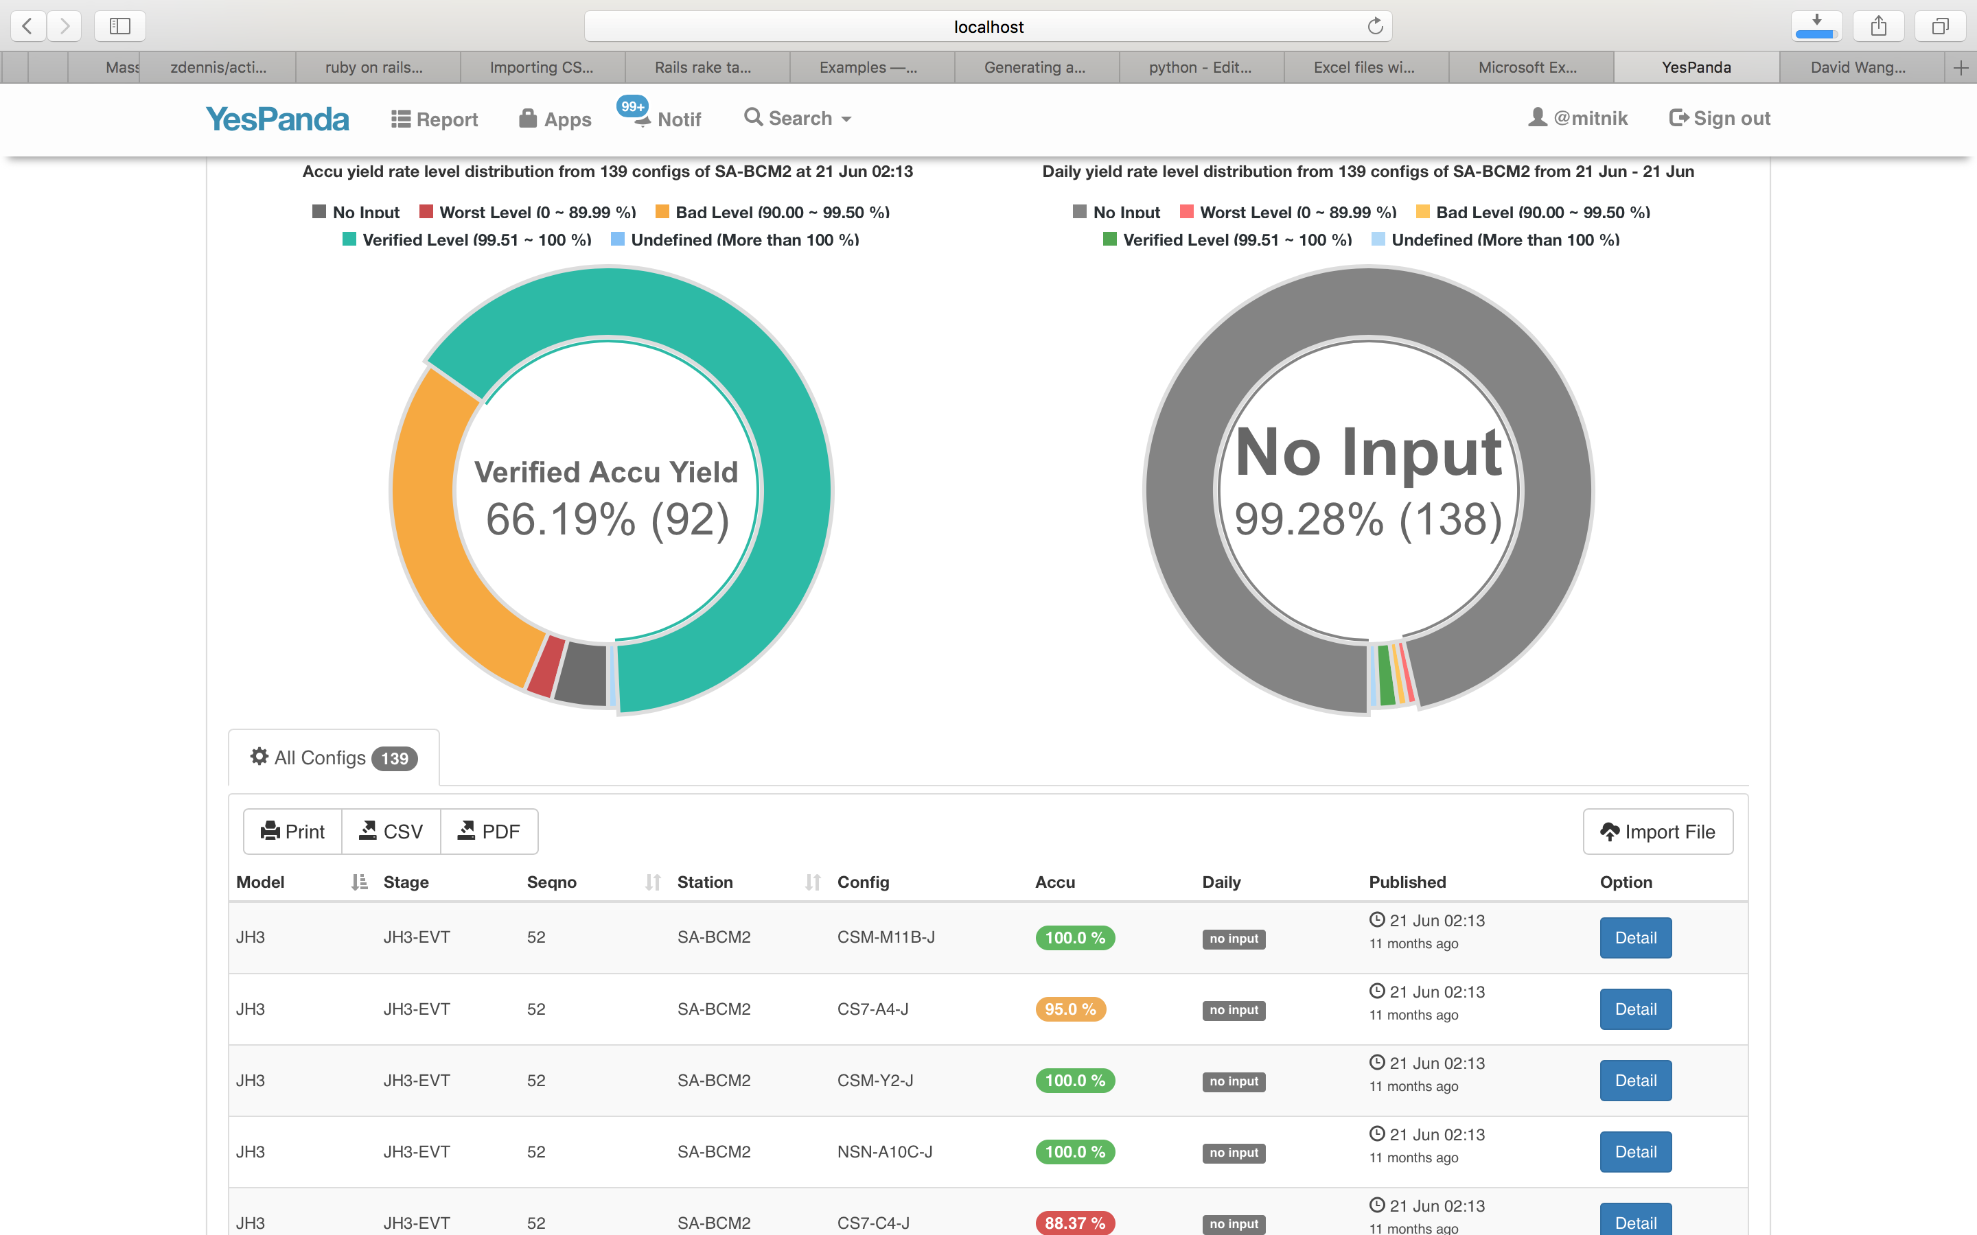
Show each Config of SA-BCM2

Slide 23
Design of Backend JSON API
[GET] http://localhost:3000/api/v1/my_posts?page=<page_num>
◆ Get all exist yield report posts (100 records per page by default)
[GET] http://localhost:3000/api/v1/my_posts/:post_id
◆ Get information of a specific post
[GET] http://localhost:3000/api/v1/my_posts/:post_id/reports?page=<page_num>
◆ Get all the yield records from a specific post (100 records per page by default)
[GET] http://localhost:3000/api/v1/my_posts/:post_id/reports?sort=<column_name>
◆ Get all the imported yield records from a specific post with given order way
[GET] http://localhost:3000/api/v1/my_posts/:post_id/reports/:report_id
◆ Get detail information of a specific yield record
[DELETE] http://localhost:3000/api/v1/my_posts/:post_id
◆ Delete a specific post with all the yield records belong to it
[DELETE] http://localhost:3000/api/v1/my_posts/:post_id/reports/:report_id
◆ Delete a specific yield record from given post
[GET] http://localhost:3000/api/v1/my_posts/:post_id/stations
◆ Return the stations list that belong to a specific post (25 records per page by default)
[GET] http://localhost:3000/api/v1/my_posts/:post_id/stations/:station_id/reports
◆ Return all yield records that belong to a specific station in a post (100 records per page by default)

Slide 24
[GET] http://localhost:3000/api/v1/my_posts?page=<page_num>
◆ Get the list of published yield posts (100 records per page by default)

Slide 25
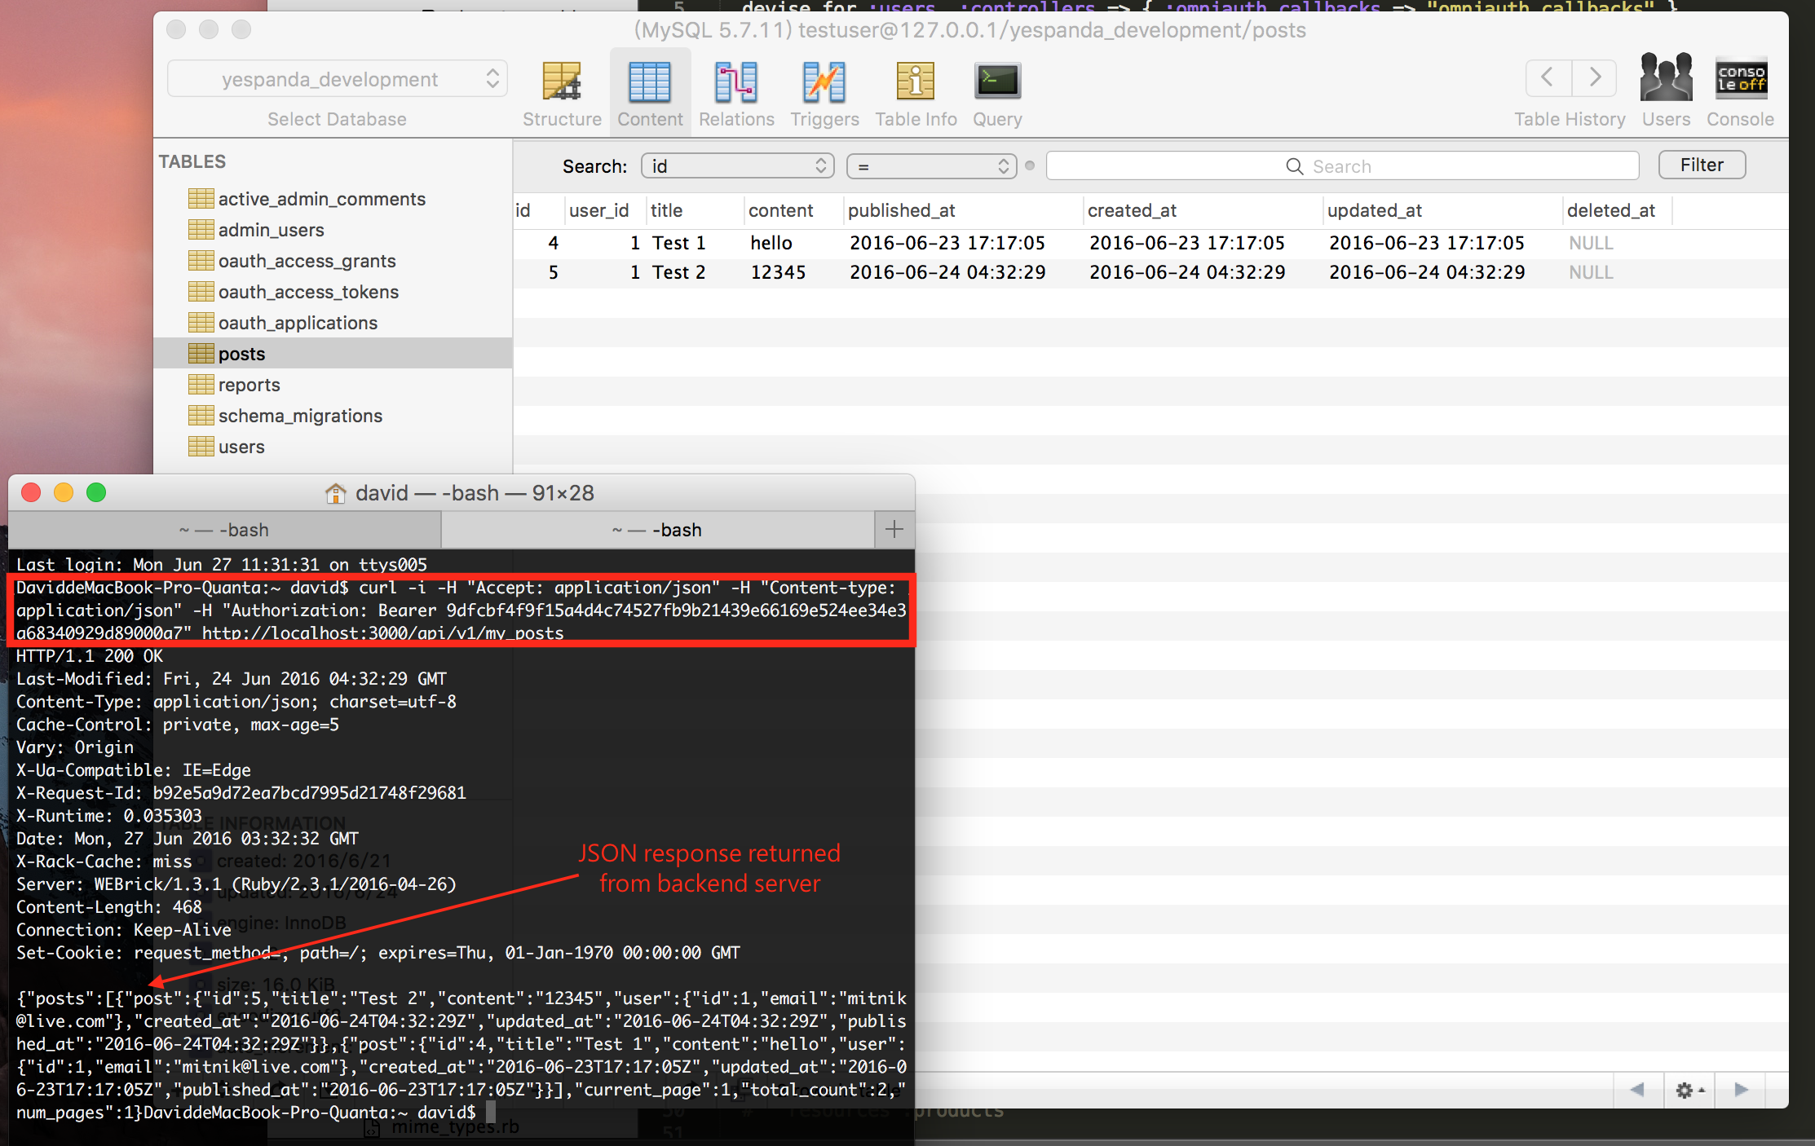
GET all Yield Reports posts
As you can see, there are currently two yield report posts in the database.

Slide 26
[GET] http://localhost:3000/api/v1/my_posts/:post_id
◆ Get information of a specific post

Slide 27
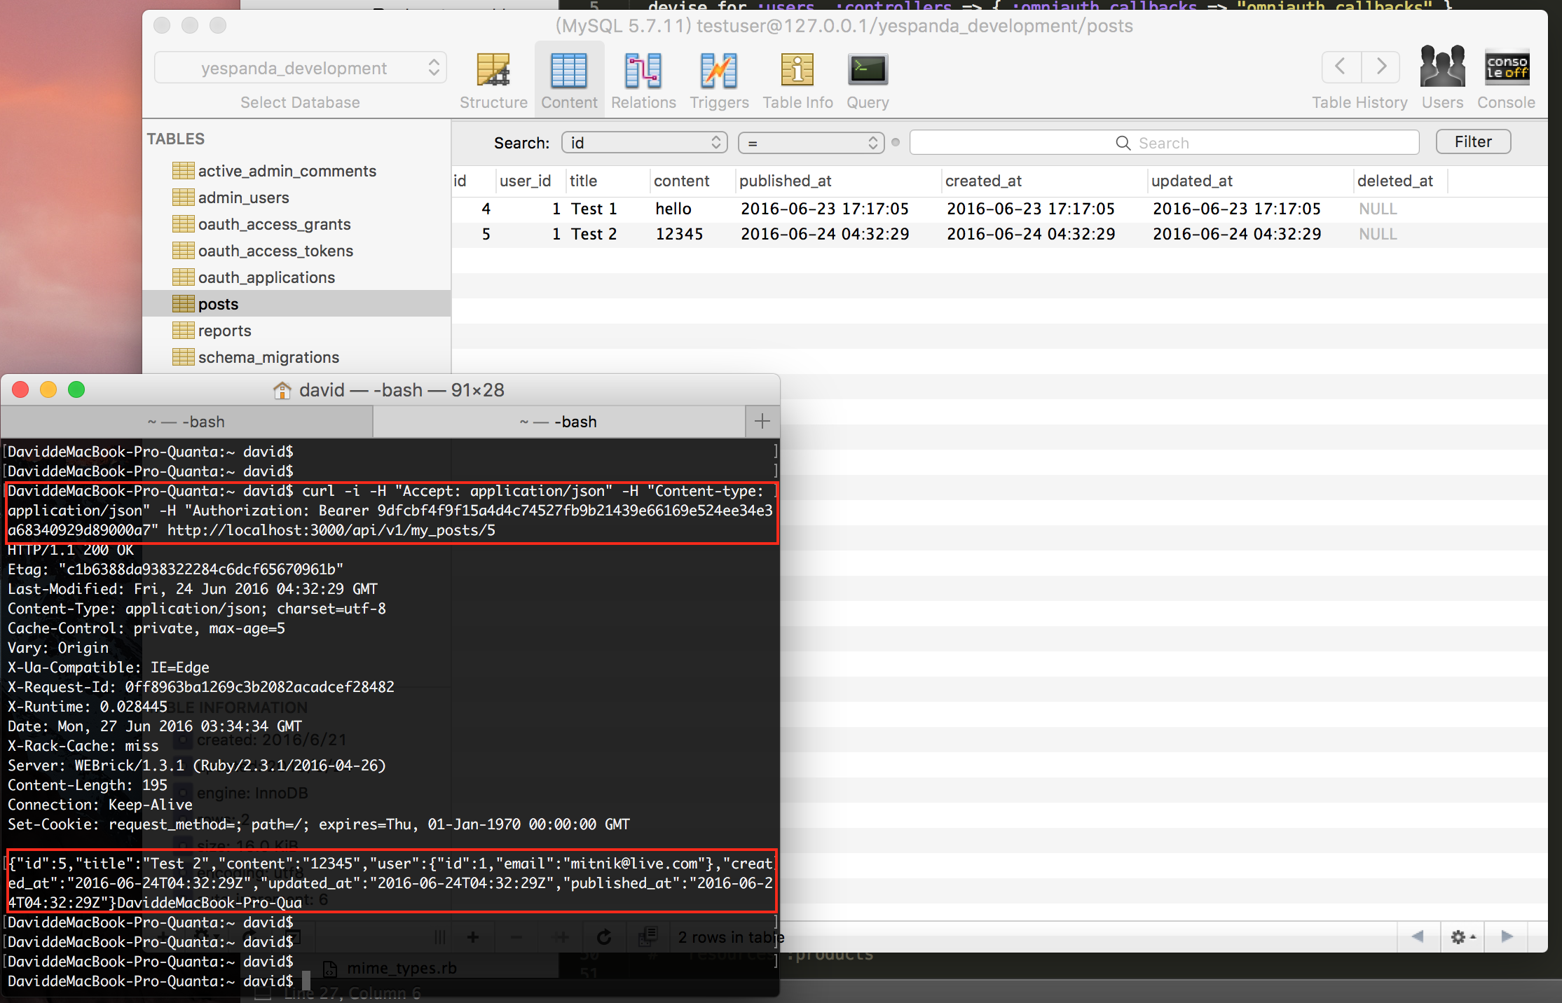
[GET] http://localhost:3000/api/v1/my_posts/5
makes server return the API response for post (id: 5) detail.

Slide 28
[GET] http://localhost:3000/api/v1/my_posts/:post_id/reports
◆ Get all the imported yield records from a specific post (100 items per page by default)
Requests that return multiple items will be paginated to 100 items. You can specify further pages with the ?page parameter.

Slide 29
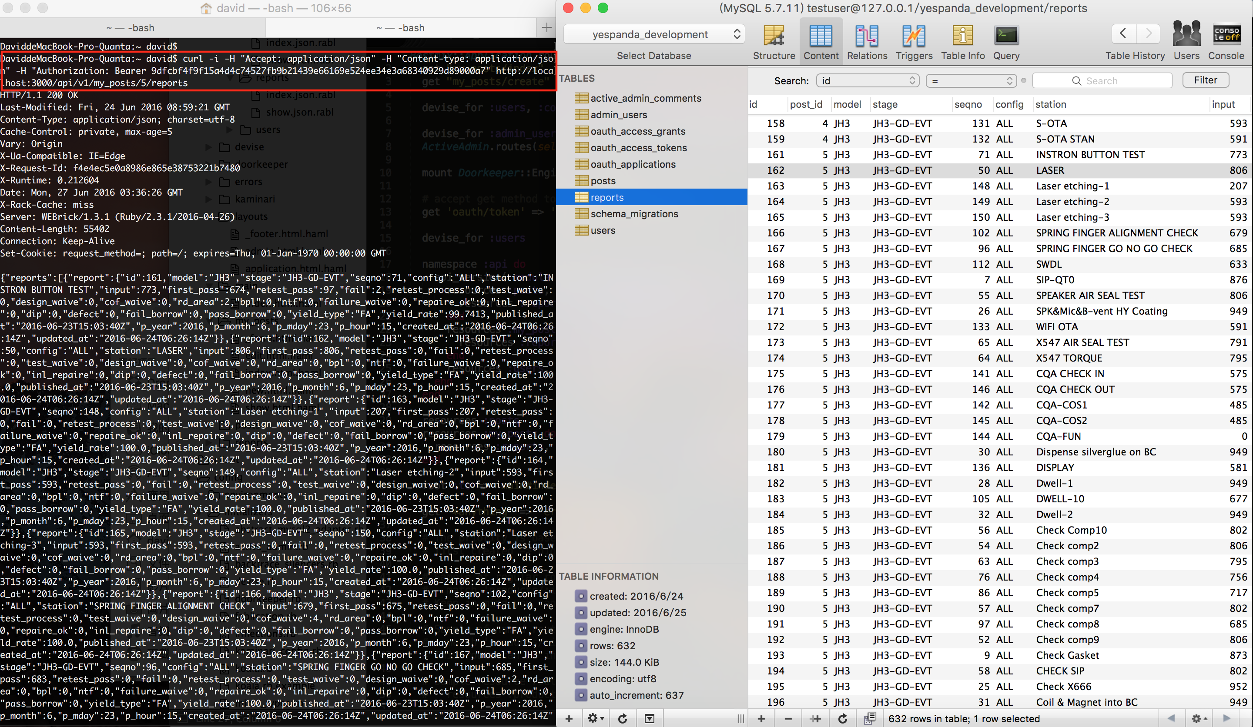
As you can see, the above HTTP GET request makes server return all the yield data with JSON format that imported to post (id: 5)
By default, the returned objects are ordered by ”Date” value in yield report CSV file.

Slide 30
Parameters
To further control the results, we support the following parameters:
page The page offset of the results. (100 records per page)
sort The order of the results. One of published_at, model, stage, seqno, station, yield_rate. (Default: published_at).

Slide 31
[GET] http://localhost:3000/api/v1/my_posts/:post_id/reports?<Parameters>
◆ Get all the imported yield records from a specific post with provided parameters

Slide 32
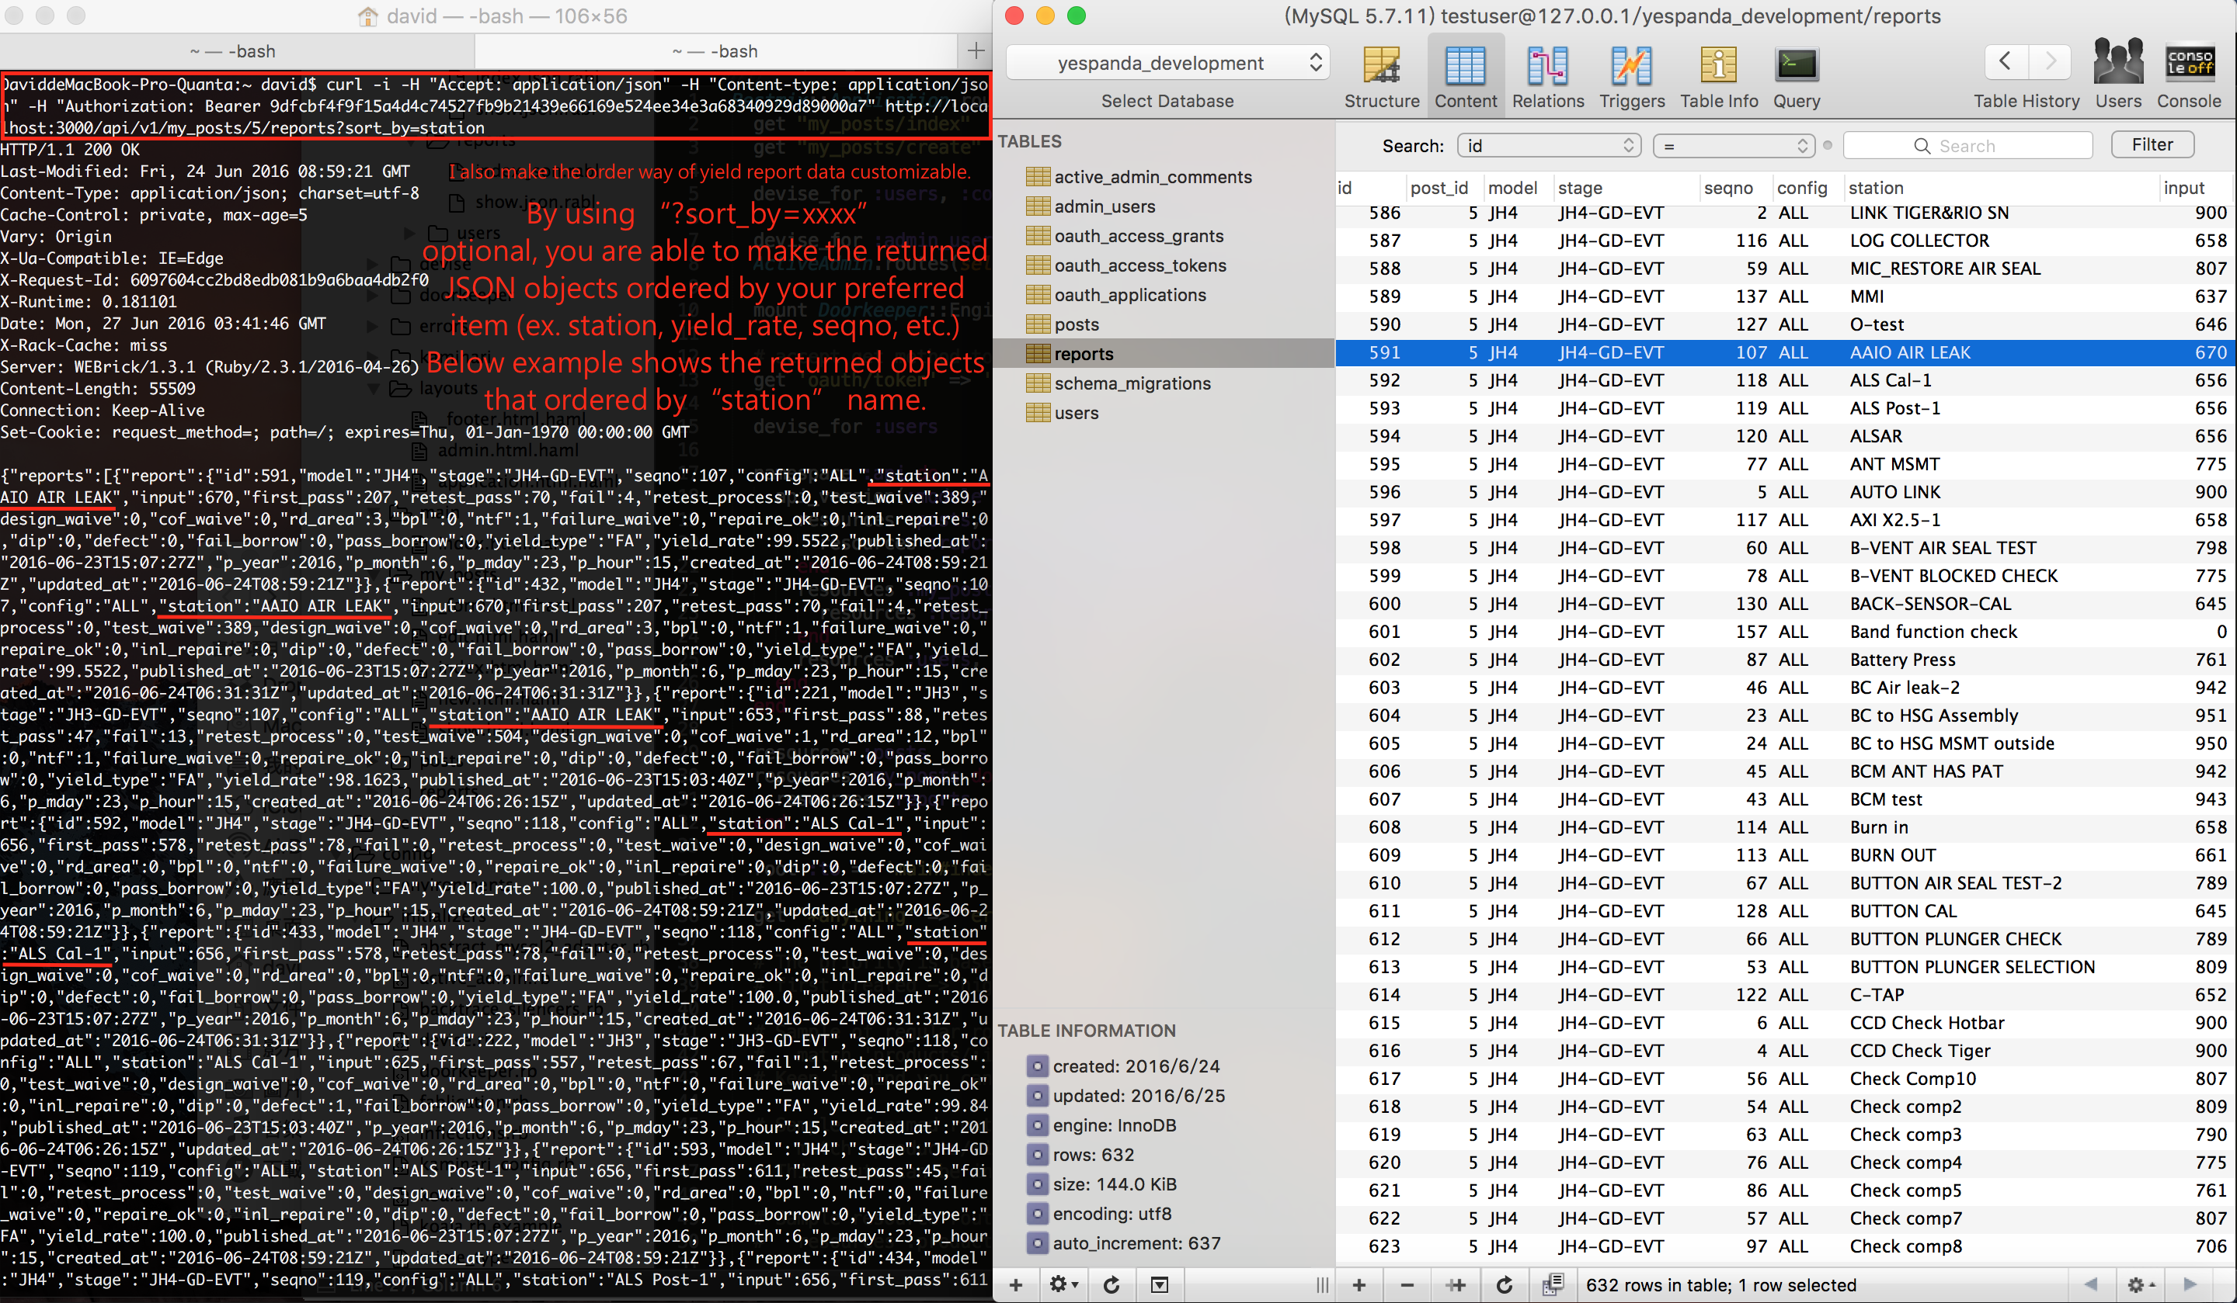

Slide 33
[GET] http://localhost:3000/api/v1/my_posts/:post_id/reports/:report_id
◆ Get detail information of a specific yield record

Slide 34
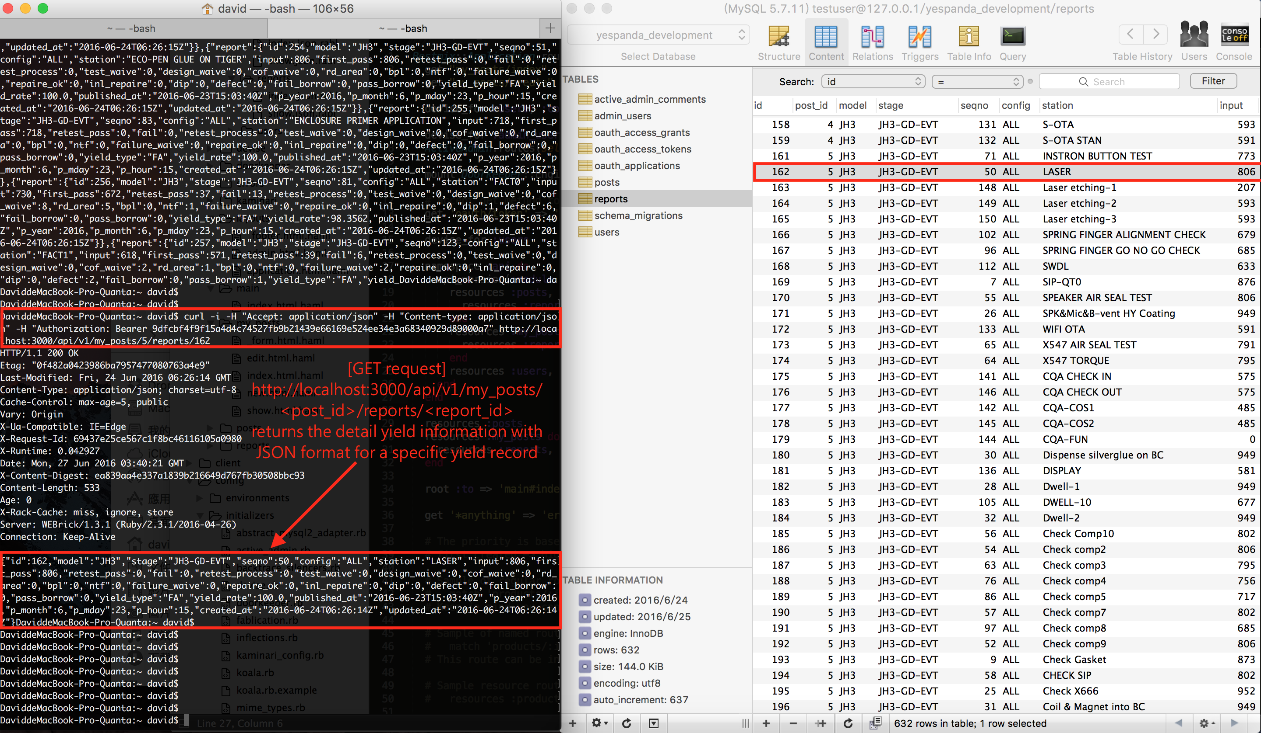

Slide 35
[DELETE] http://localhost:3000/api/v1/my_posts/:post_id
◆ Get detail information of a specific yield record

Slide 36
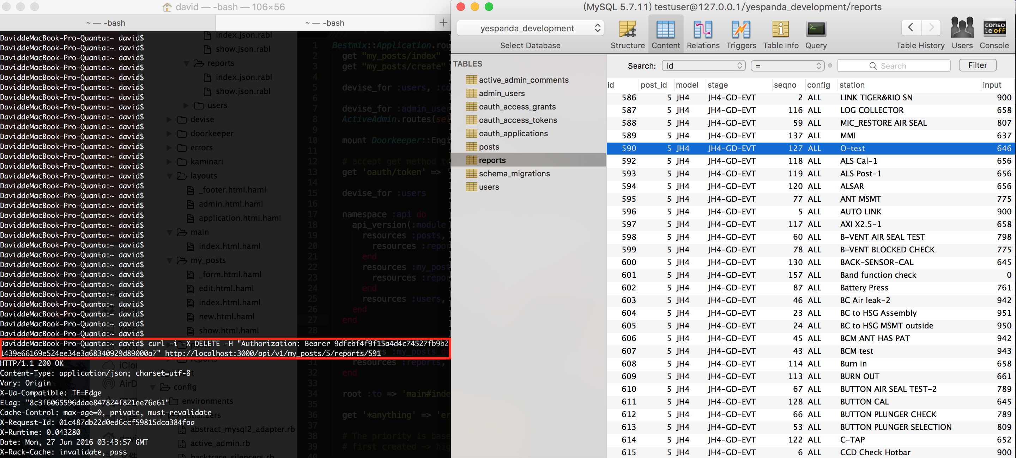
[DELETE request]
http://localhost:3000/api/v1/my_posts/<post_id>/reports/<id>
makes the deletion effect of a specific yield data in targeted yield post.
The below example shows the deletion of report (id: 591) from post (id: 5)
After the HTTP request, you can see the yield data with id:591 has been deleted from database.

Slide 37
[DELETE] http://localhost:3000/api/v1/my_posts/:post_id/reports/:report_id
◆ Delete a specific yield record from given post

Slide 38
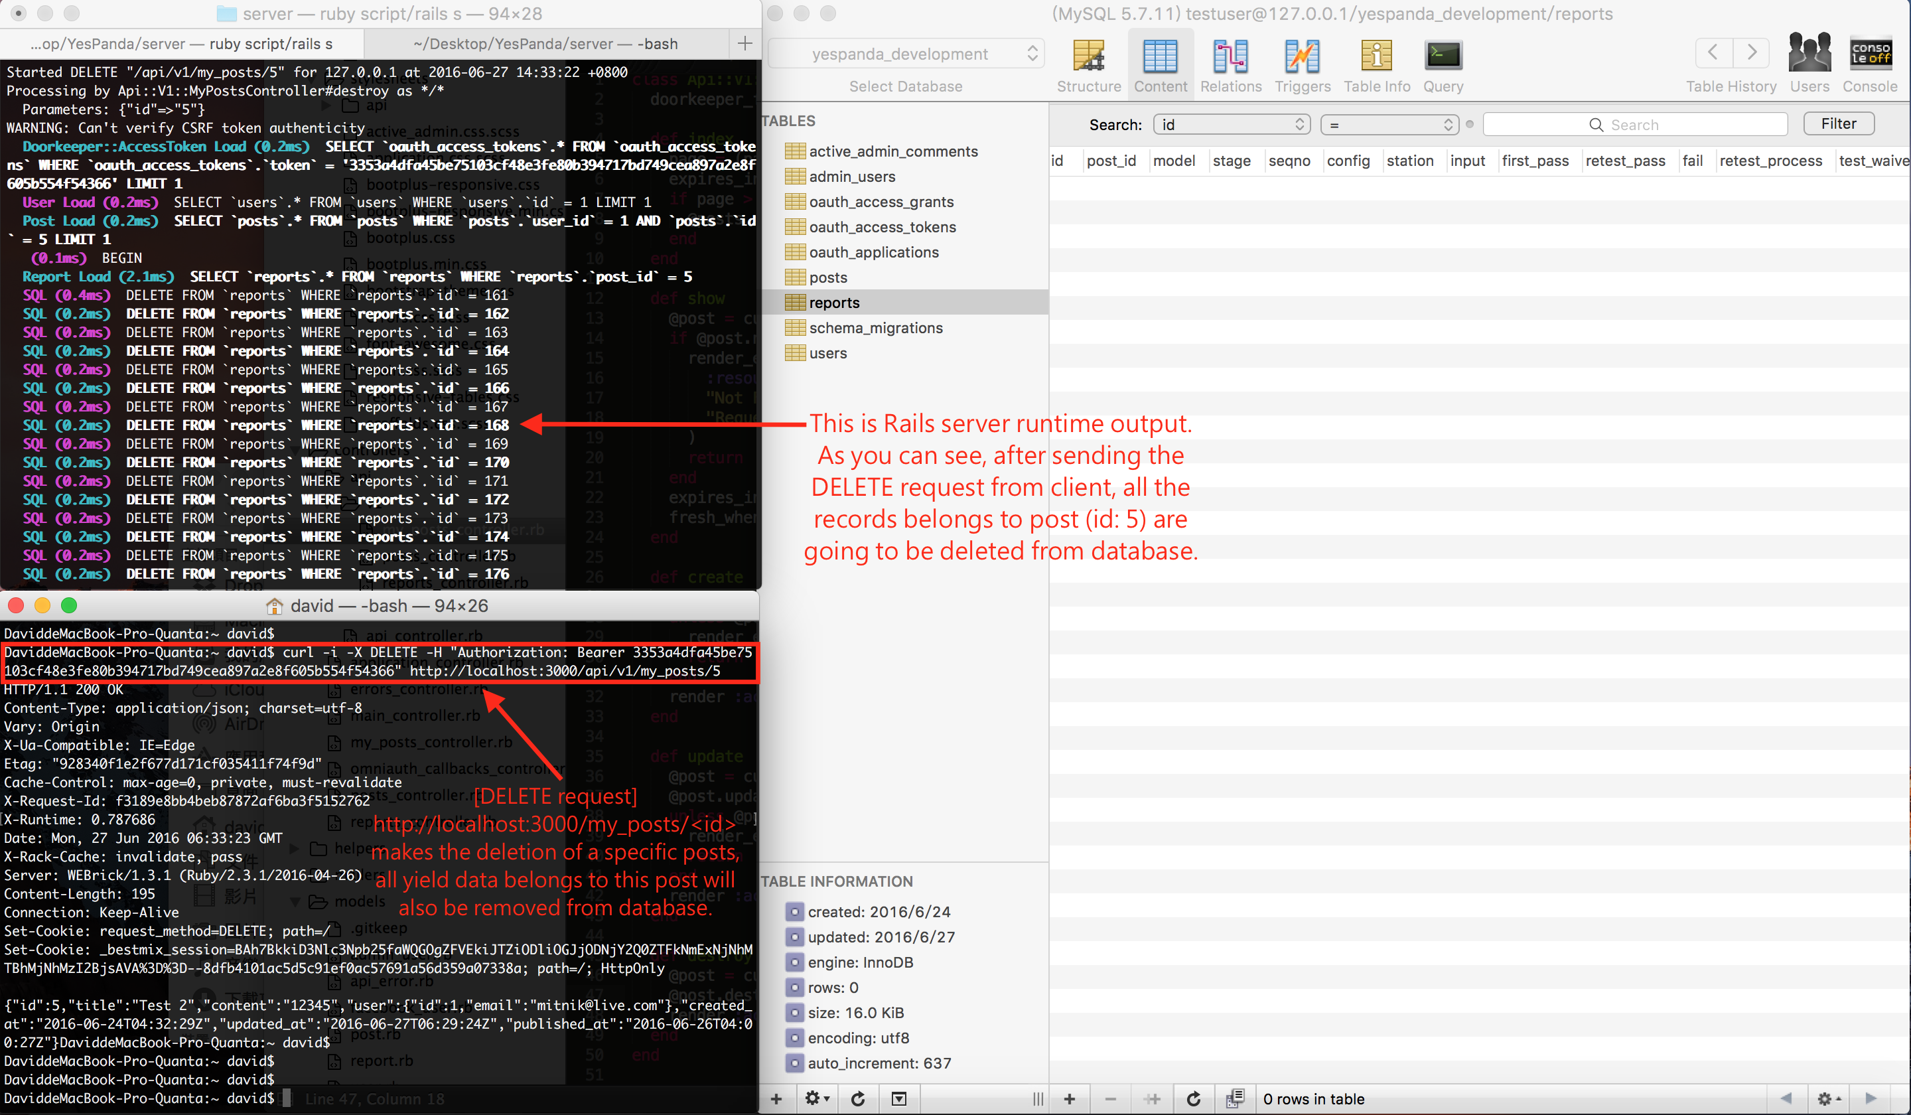

Slide 39
[GET] http://localhost:3000/api/v1/my_posts/:post_id/stations
◆ List all stations belong to a specific post

Slide 40
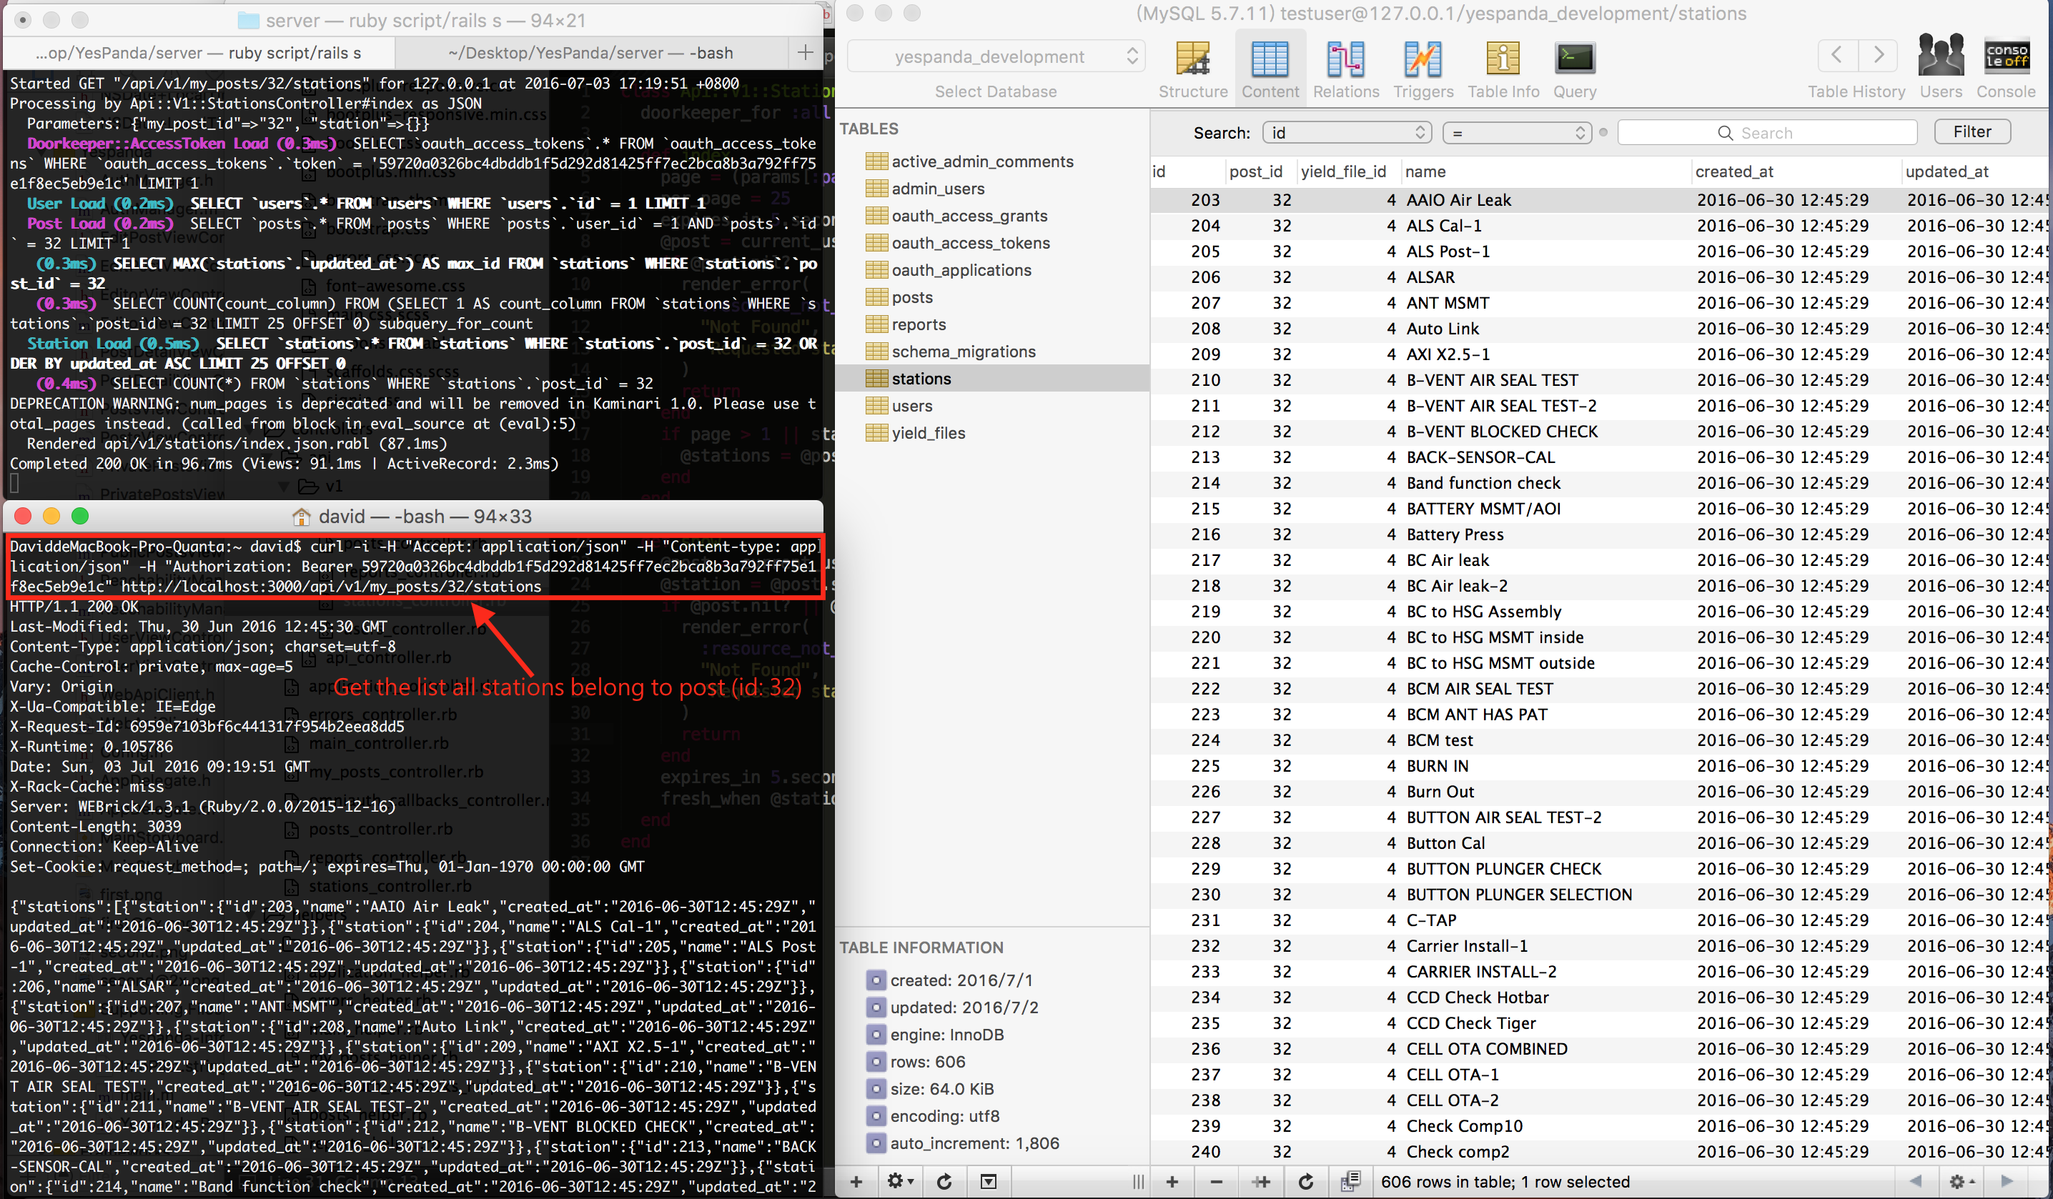

Slide 41
[GET] http://localhost:3000/api/v1/my_posts/:post_id/stations/:station_id/reports
Return all report records that belong to a specific station in a specific post

Slide 42
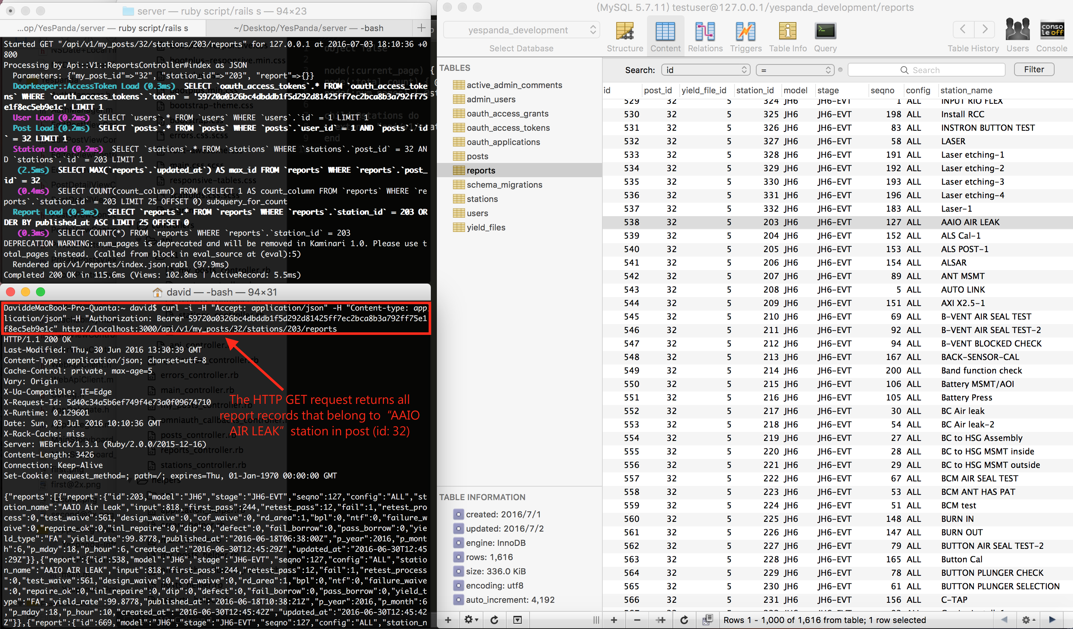

Slide 43


